Slide 1
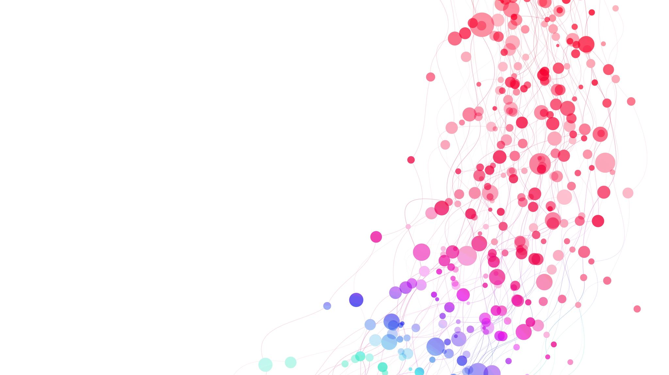
The acutely deteriorating patient with a neurological condition
Dr Carmen Lopez Soto
Consultant in Critical Care
King’s College Hospital NHS Foundation Trust

Slide 2
I am a doctor…

Slide 3
Outline
Definition of neurological deterioration
Clinical assessment of the patient with neurological impairment
Initial management as the critical care outreach team
Seizures
Sepsis in the neurologically impaired patient

Slide 4
Commonest trigger: unresponsiveness/seizures (23%)
Underlying Neurological diagnoses 30%

Slide 5
Neurological deterioration
The occurrence of one or more of the following:
a spontaneous decrease in GCS motor score of at least 2 points
a new loss of pupillary reactivity
interval development of pupillary asymmetry of at least 2mm or
deterioration in neurological status sufficient to warrant immediate medical or surgical intervention
Morris GF, et al. Neurosurgery. 1998 Dec;43(6):1369-72; discussion 1372-4. PMID: 9848851.
Notes:
Selfotel trial

Slide 6
Early vs Late Neurological deterioration
Death
Poor Health related quality of life

Slide 7
Critical Neuro-worsening in TBI
Spontaneous decrease in the GCS motor score ≥1 point
New decrease in pupillary reactivity
New pupillary asymmetry or bilateral mydriasis
New focal motor deficit
Herniation syndrome or Cushing’s Triad that will require an immediate medical response

Slide 8
Which patients?
Stroke (ischemic and haemorrhagic)
Subarachnoid haemorrhages
Traumatic brain injuries
Post-op elective patients
Central Nervous system (CNS) infection
CNS inflammatory disease

Slide 9
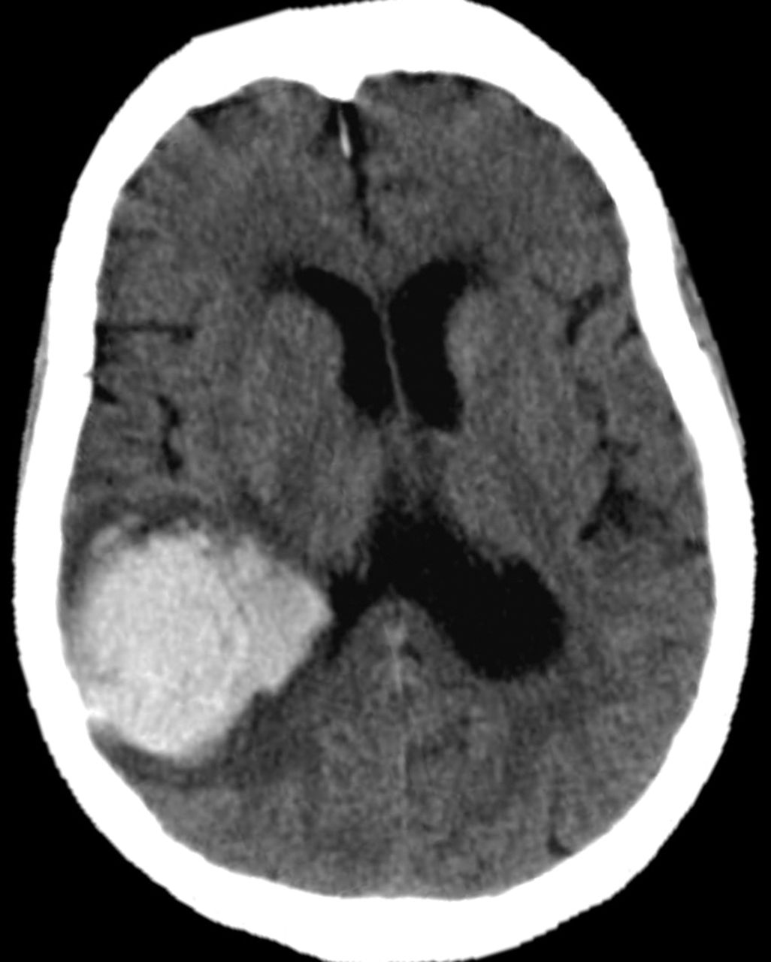
ICH - Risk factors
Higher NIHSS
Hematoma Volume and expansion
Presence of intraventricular hemorrhage and extension
Spot sign on CTA
Higher SBP
Hyperglycaemia
Renal impairment
Higher leukocytes
Antithrombotic drugs
Lobar ICH
Journal of Neurology (2024) 271:2980–2991

Slide 10
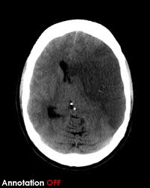
Stroke - Risk factors
Hypotension/Hypertension
Hyperglycemia
Hypercolesterolaemia
Higher NIHSS (>7)
Proximal arterial occlusion
Location: basal ganglia
Large artery occlusion
Inflammation
Cerebrovasc Dis. DOI: 10.1159/000543763

Slide 11
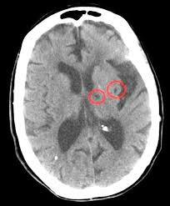
Stroke – Lacunar infarcts
Small subcortical infarct and occlusion of small perforating artery
Pure motor of sensory hemiparesis
Ataxic hemiparesis
Dysarthria-clumsy hand syndrome
Sensorimotor stroke
Incidence 23.54%
Mostly within 24hr
NIHSS $≥$2 point
Decline in motor score
Female
Hypertension
Diabetes
Smoking

Slide 12
Cause | Common symptoms and signs
New stroke | New focal neurological deficits Loss of consciousness if contra-lateral or brain stem
Progressive stroke | Worsening existing neurological deficits Deterioration of level of consciousness
Development of oedema | Decreased level of consciousness Unilateral pupil dilatation
Increased ICP | Depressed level of consciousness Posturing Respiratory changes Haemodynamic changes (Cushing’s response)
Seizures | Aversive eye deviation Focal motor involuntary movement Worsening existing deficits Abrupt deterioration in level of consciousness Respiratory changes Haemodynamic changes
Haemorrhagic transformation of infarct | Similar to progressive stroke Similar to development of oedema and raised ICP
Siegler JE, Martin-Schild S.. International Journal of Stroke. 2011;6(3):211-212. doi:10.1111/j.1747-4949.2011.00596.x

Slide 13
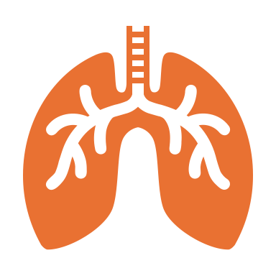
Assessment
A
B
C
D
E
Obstruction
C-spine
Secretions
Objects
Oedema
Look-listen-feel
Respiratory rate
BPM
Added sounds
HR, BP, CRF
Skin colour
Diuresis
GCS/AVPU
Pupils
Glucose
Expose
Scars
Other injuries
Temperature

Slide 14
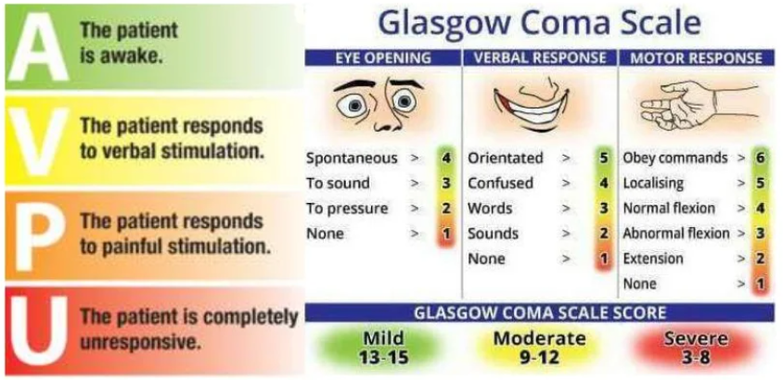
Neurological assessment
Romanelli D, Farrell MW. AVPU Scale.StatPearls Publishing; 2025 Jan–. PMID: 30860702.
Teasdale G, Jennett B. Assessment and prognosis of coma after head injury. Acta Neurochir (Wien). 1976;34(1-4):45-55. doi: 10.1007/BF01405862. PMID: 961490.

Slide 15
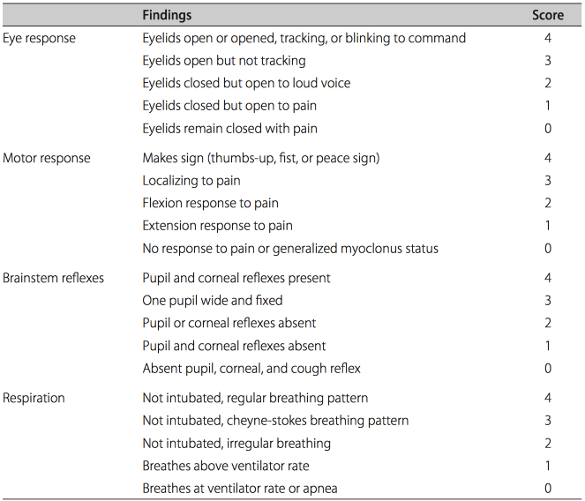
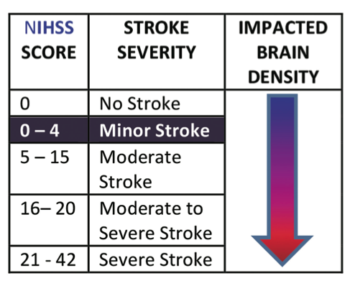
Neurological assessment
FOUR Score
NIHSS Score
Wijdicks EF, Bamlet WR, Maramattom BV, Manno EM, McClelland RL. Ann Neurol. 2005 Oct;58(4):585-93. doi: 10.1002/ana.20611. PMID: 16178024.
https://strokesciences.com/the-national-institutes-of-health-stroke-scale-nihss/

Slide 16
Hypotension
Intracranial hypertension
Secondary injury
Hypoxemia
Ischemia
Hypocapnia
Hyperemia
Hypo/Hyperthermia
Oedema
Metabolic disturbances
Hemorrhage

Slide 17
Initial interventions
A
B
C
D
E
Open airway
Intubation
Maintain oxygenation
Sp02>94%
Maintain
SBP 130-140
MAP 80
Urine catheter
NGT
Maintain temperature
Blood cultures

Slide 18
Interventions
Hypertonic saline/mannitol
Sedation
Intubation
Antiepileptic drugs
CTH +/- further interventions

Slide 19
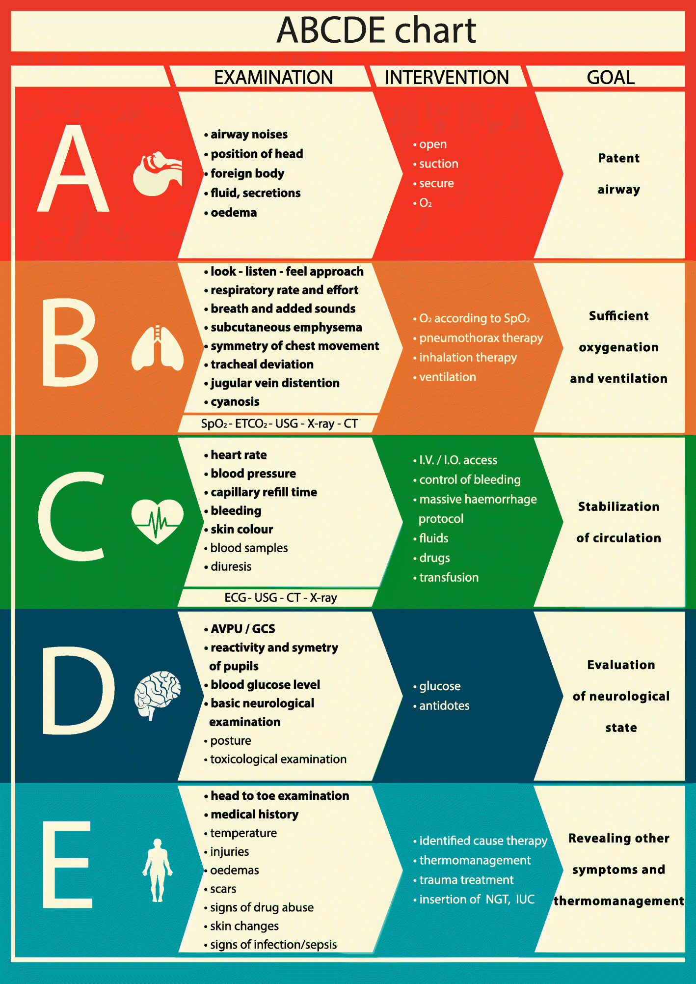

Slide 20
Response to Critical Neuro-worsening if herniation is suspected
Empiric treatment
Hyperventilation (PaCO2 3.5-4kPa)
Bolus of hypertonic solution
Consider emergent imaging or other test (EEG)
Rapid escalation of treatment

Slide 21
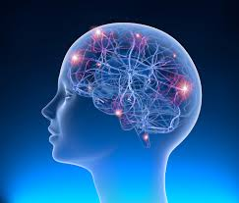
Seizures
Seizure
Uncontrolled, abnormal electrical activity of the brain that may cause changes in the level of consciousness, behaviour, memory, or feelings
Generalised Tonic Clonic Seizure
Seizure that has a tonic phase followed by clonic muscle contractions
Status Epilepticus
Seizure with 5 minutes or more of continuous clinical and/or electrographic activity or recurrent seizure activity without recovery between seizures
Neurological emergency
Notes:
requiring immediate evaluation and management to prevent significant morbidity or mortality

Slide 22
Causes
Central nervous system (CNS) infections (meningitis, encephalitis, and intracranial abscess)
Metabolic abnormalities (hypoglycemia, hyponatremia, hypocalcemia, hepatic encephalopathy, and inborn errors of metabolism in children)
Cerebrovascular accidents
Head trauma (with or without intracranial bleed)
Drug toxicity
Drug withdrawal syndromes (e.g., alcohol, benzodiazepines, and barbiturates)
Hypoxia
Hypertensive emergency
Autoimmune disorders

Slide 23
Management
primary goal of management is to definitively abort seizure activity as rapidly as possible

Slide 24
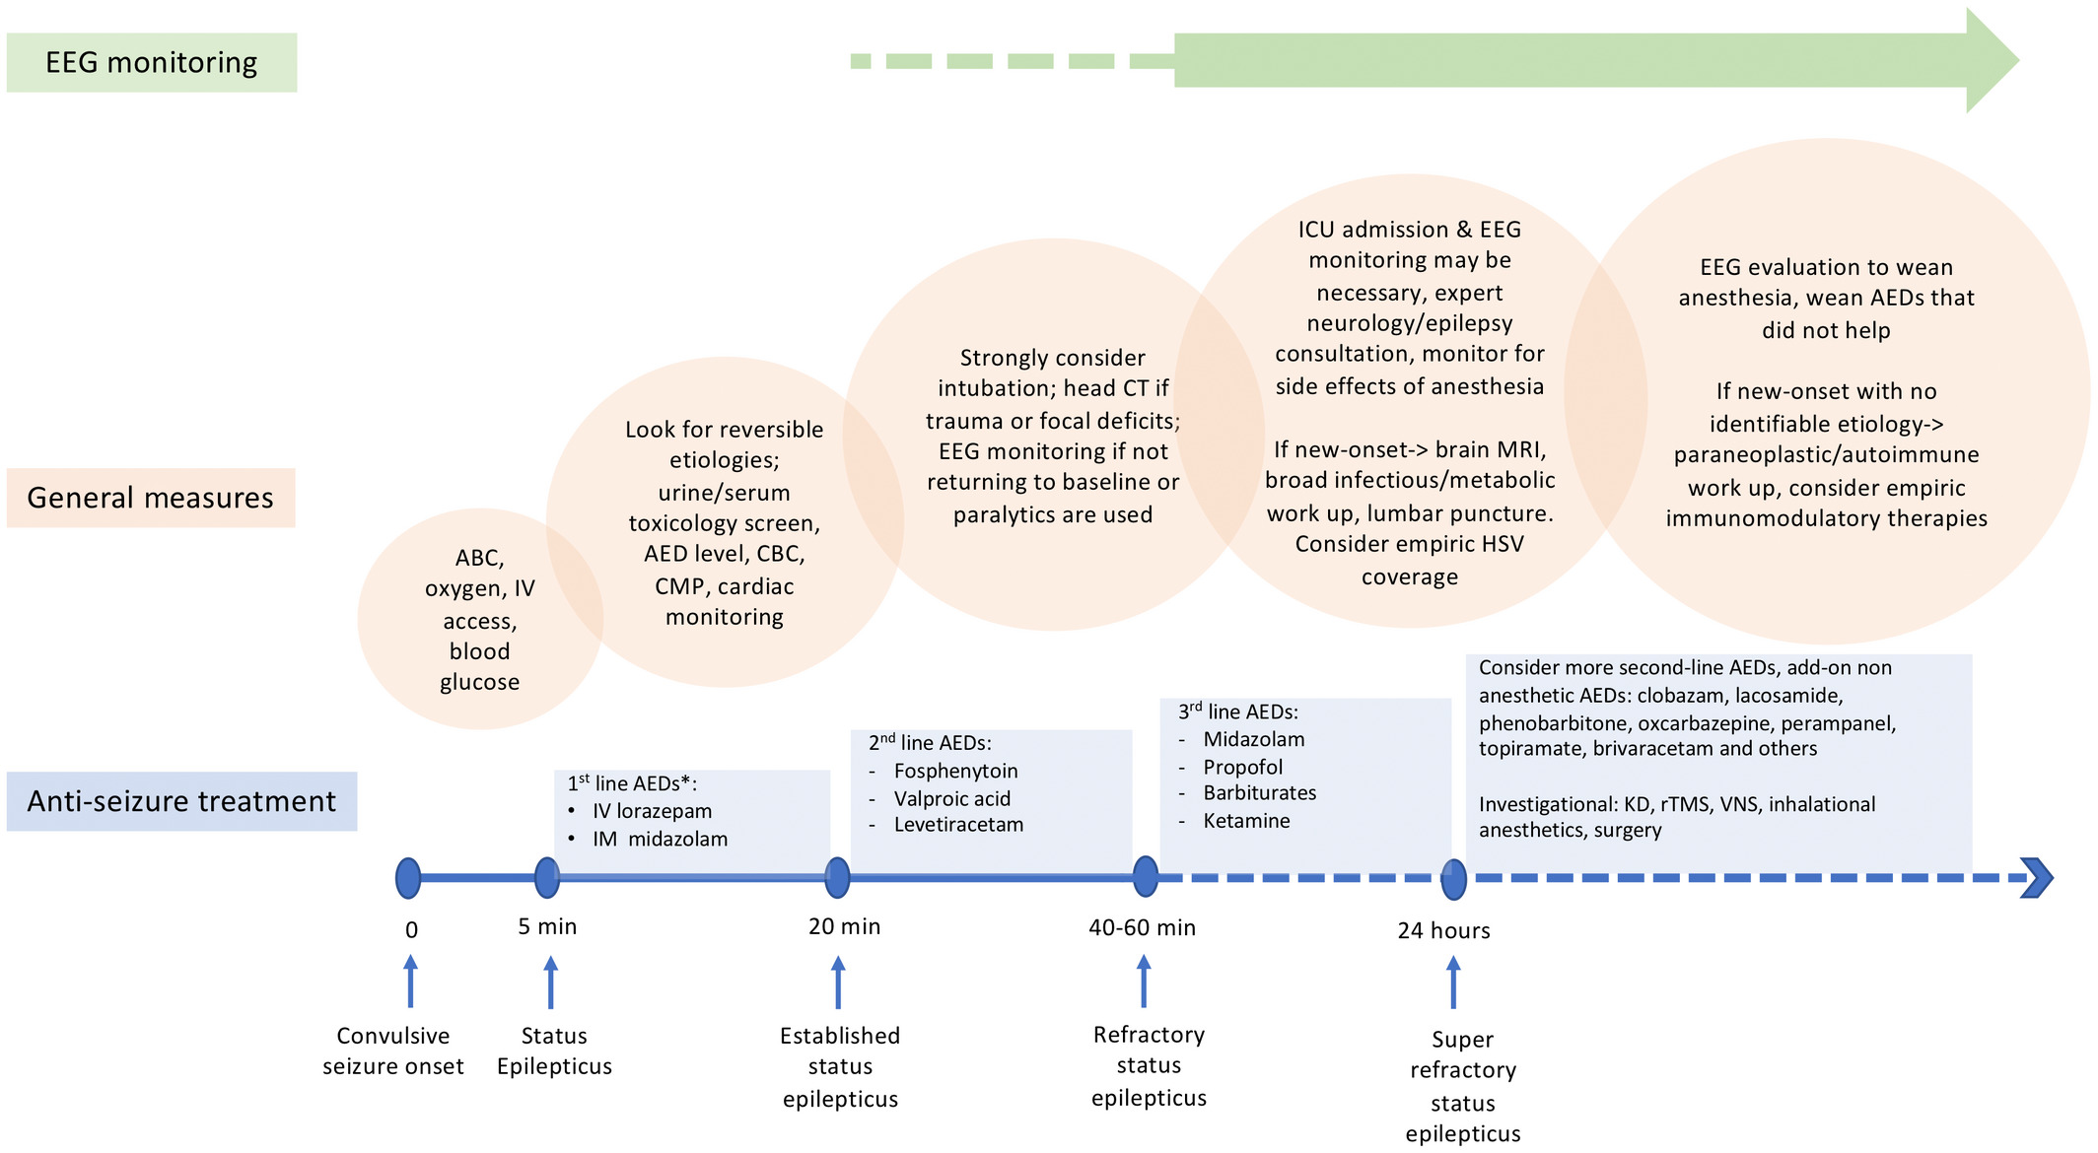
Management of status epilepticus
Anaesthesia, Volume: 77, Issue: S1, Pages: 78-91, First published: 10 January 2022, DOI: (10.1111/anae.15606)
Notes:
Treatment timeline of convulsive status epilepticus. *intramuscular (IM) or buccal (depending on availability) preferred in patients without i.v. access. Diazepam can be used if lorazepam and midazolam are not available. ABC, airway, breathing and circulation; IV, intravenous; AED, anti‐epileptic drug; CBC, complete blood count; CMP, complete metabolic panel; CT, computed tomography; EEG, electroencephalogram; MRI, magnetic resonance imaging; KD, ketogenic diet; rTMS, repetitive transcranial magnetic stimulation; and VNS, vagal nerve stimulator.
IF THIS IMAGE HAS BEEN PROVIDED BY OR IS OWNED BY A THIRD PARTY, AS INDICATED IN THE CAPTION LINE, THEN FURTHER PERMISSION MAY BE NEEDED BEFORE ANY FURTHER USE. PLEASE CONTACT WILEY'S PERMISSIONS DEPARTMENT ON PERMISSIONS@WILEY.COM OR USE THE RIGHTSLINK SERVICE BY CLICKING ON THE 'REQUEST PERMISSIONS' LINK ACCOMPANYING THIS ARTICLE. WILEY OR AUTHOR OWNED IMAGES MAY BE USED FOR NON-COMMERCIAL PURPOSES, SUBJECT TO PROPER CITATION OF THE ARTICLE, AUTHOR, AND PUBLISHER.

Slide 25
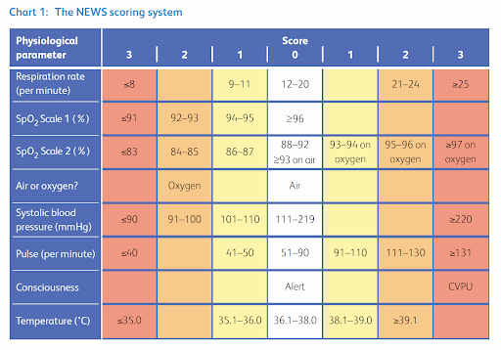
Sepsis in the neurologically impaired patient

Slide 26
DOI: 10.1097/CCE.0000000000000386
Spinal Cord (2020) 58:165–173
https://doi.org/10.1038/s41393-019-0330-0

Slide 27
Patients with neurological conditions and high MEWS-SR have higher mortality
MEWS-SR is not a realiable tool to indicate new infection or sepsis
A high proportion of patients with MEWS-SR >5 did not have sepsis/infection
Mortality was not driven by sepsis or infection

Slide 28
Contact me
carmen.lopezsoto@nhs.net

