Slide 1

Chest Auscultation
Julia Phillips Nurse Consultant Critical Care & Outreach

Slide 2
Chest Examination
When to perform
Concerning symptoms
Remember end of bed test
INSPECTION, PALPATION
AUSCULTATION
Notes:
Common/Concerning symptoms
Chest pain, SOB, Haemoptysis, Wheeze, Cough
Any pain? Before proceeding

Slide 3
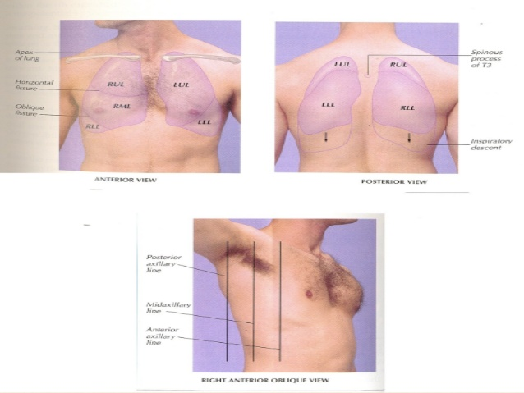
End of Bed
Patient Identity
Consent
Privacy and Dignity
Changes in Pregnancy
Anterior and Posterior examination- remember landmarks
Notes:
Pregnancy- large breasts and splinting of the diaphragm
Aim for high 90s Sp02
Inspect from the end of the bed- SOB, use of accessory muscles, positioning, cyanosis, audible sounds ie wheeze/stridor, cough, secretions
Remember landmarks- don’t forget bases

Slide 4
Inspection
Use of accessory muscles
Positioning
SOB
Pain
Sp02
Cyanosis
Count RR over a minute
Notes:
Inspect the chest- deformities, rise and fall, scars, lift arms up- lateral thoracotomy scar?
Position of trachea- central or deviated
Look at hands note any peripheral cyanosis- late sign
Nicotine staining- smoker, long term steroids- thin skin or bruising
Temperature check
Assess for fine tremor- B2 antagonist- salbutamol- hand out flat
Hands extended at the wrist- look for flap- CO2 retention
Feel pulse and count resp rate over one minute-
Rate, depth, rhythm and effort of breathing
Inspect face and eyes- inspect for central cyanosis- hypoxia
Conjunctival pallor- anaemia of pregnancy
Look inside the mouth- central cyanosis, oral thrush

Slide 5
Palpation
Chest Expansion
Percussion
Normal lungs- resonant
Dull- fluid/solid
Hyper-resonant
Notes:
Chest expansion- bilateral, unilateral, reduced?
Percussion – normal resonant
Dull- effusion (stoney dull) consolidation
Hyper resonant pneumothorax

Slide 6
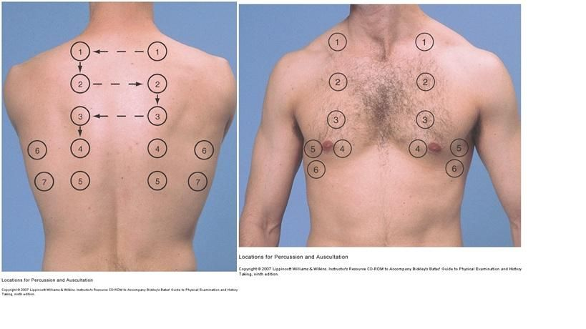
Auscultation-What’s Normal?
Vesicular breath sounds- normal 2/3 inspiratory to expiration
Practice at home!
Good stethoscope remember lung bases
Use diaphragm
Notes:
What is normal?
Systematic examination across anterior and posterior lung fields as per diagram
Vesicular quiet breathes- 2/3 insp to 1/3 exp

Slide 7
Adventitious sounds- added
Continuous vs discontinuous
Crackles fine vs coarse
Musical sounds
Differential diagnosis
Notes:
Stridor- inspiratory wheeze
Wheeze- expiratory in asthma
Coarse Crackles- consolidation can clear on coughing ie secretions
Bronchial breath sounds- hollow- gap in between insp and exp- consolidation
Fine crackles- pulmonary oedema
Remember to auscultate posterior wall- request patient to breathe normally- breathe in and out mouth
Sacral and pedal oedema in overload
Assess for signs of deep vein thrombosis- pain in calfs
Remember Sp02, monitoring, handover and documentation

Slide 8
LISTEN AND PRACTICE
https://www.youtube.com/watch?v=2NvBk61ngDY

Slide 9
Case Study
25 year old asthmatic
Presented with SOB and productive cough
2nd trimester
RR 25
Sp02 92% on RA
Able to talk in short sentences
Treatment- BLS guidelines
Notes:
Remember modes of oxygen- what masks how much flow- nasal specs, Hudson mask, non rebreathe
When to call for help
Auscultation- expiratory wheeze- polyphonic

Slide 10
Case Study
30 year old raised BMI
3rd Trimester
Pre-eclampsic
Magnesium infusion and fluids
Fluid balance +ve 3 Litres
Now SOB
Increasing oxygen requirement
Use of accessory muscles
Distressed
Notes:
Remember positioning and monitoring- remember fluid balance!
Auscultation fine crackles

Slide 11
Case Study
22 year old lady
2nd Trimester
Presented with pyrexia
Oxygen requirement
PCR COVID –ve
CAP
Productive- poor cough
C-xray- bibasal pneumonia
Notes:
IVAB- respiratory input ? Move to general ward
Importance of chest physio
Auscultation coarse crackles and reduced AE bi-basally- bronchial breath sounds
Type 1 RF- HFNO?

Slide 12
Bronchial breath sounds
https://www.youtube.com/watch?v=WfkWMfE9VTY

