Slide 1










STATE OF THE NATIONS
Critical Care Outreach — From Origins to Today
ENGLAND
WALES
Origins & Evolution
CRITICAL CARE
OUTREACH
A National Journey
Mark Wilson
Vanessa Jones
Early recognition
Early intervention
Better outcomes
IRELAND
JAPAN
Emerging & ANP-led
RRS & Outreach Models
Siobhan Tierney-Pyke
Ayako Noguchi
ORIGINS
DEVELOPMENT
EXPANSION
WHERE ARE WE NOW?
BACCN × NOrF • Belfast 2026
Four nations • Different journeys • A shared purpose
Notes:
Session opener. Speaking order: England, Wales, Ireland, Japan. The concept is Siobhan's, kept as agreed; this version tidies the layout and makes the NOrF logo prominent.
Presenter titles, for reference (cards show names only):
- Mark Wilson: Advanced Nurse Practitioner, Critical Care Outreach; Clinical Lead for Deterioration (Martha's Rule), Health Innovation Oxford and Thames Valley; Co-Vice Chair, NOrF
- Vanessa Jones: Interim Lead Nurse, Resuscitation, Acute Deterioration and Outreach Services, Cwm Taf Morgannwg University Health Board
- Siobhan Tierney-Pyke: Advanced Nurse Practitioner in Critical Care Outreach, Beaumont Hospital, Dublin; Co-opted NOrF member representing the Irish Chapter (iNOrF)
- Ayako Noguchi: RN, CCNS, MSN, PhD; Institute of Science Tokyo (title to be confirmed with her)
Community of Practice discussion: Day 2, final session.

Slide 2
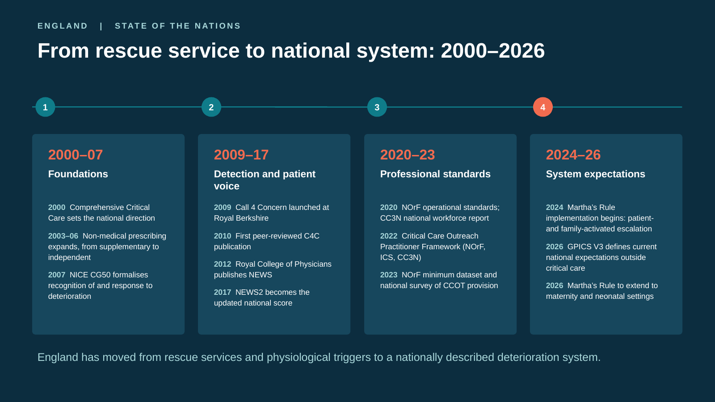
Notes:
[Target: about 1 min 10 sec]
Hello everyone. I'm Mark Wilson, an Advanced Nurse Practitioner in Critical Care Outreach at Royal Berkshire, and I'll briefly describe the position in England.
The story begins in 2000, when Comprehensive Critical Care took critical-care expertise beyond the ICU. Non-medical prescribing expanded, NICE formalised the response to deterioration, and NEWS and NEWS2 created a common language for physiological risk.
Call 4 Concern, introduced at Royal Berkshire in 2009, brought the patient and family voice into escalation. More recently, NOrF, CC3N and the Intensive Care Society have developed standards, workforce guidance and a minimum dataset.
England has therefore moved from individual rescue services to a nationally described deterioration system.
Transition: That development has created widespread coverage, but it has not created consistent provision.
Sources: Comprehensive Critical Care (DH, 2000); NICE CG50 (2007); RCP NEWS/NEWS2; Odell 2010 and 2019 (Call 4 Concern); CC3N 2020; NOrF 2020, 2023; CCOP Framework (NOrF, ICS, CC3N, 2022).

Slide 3
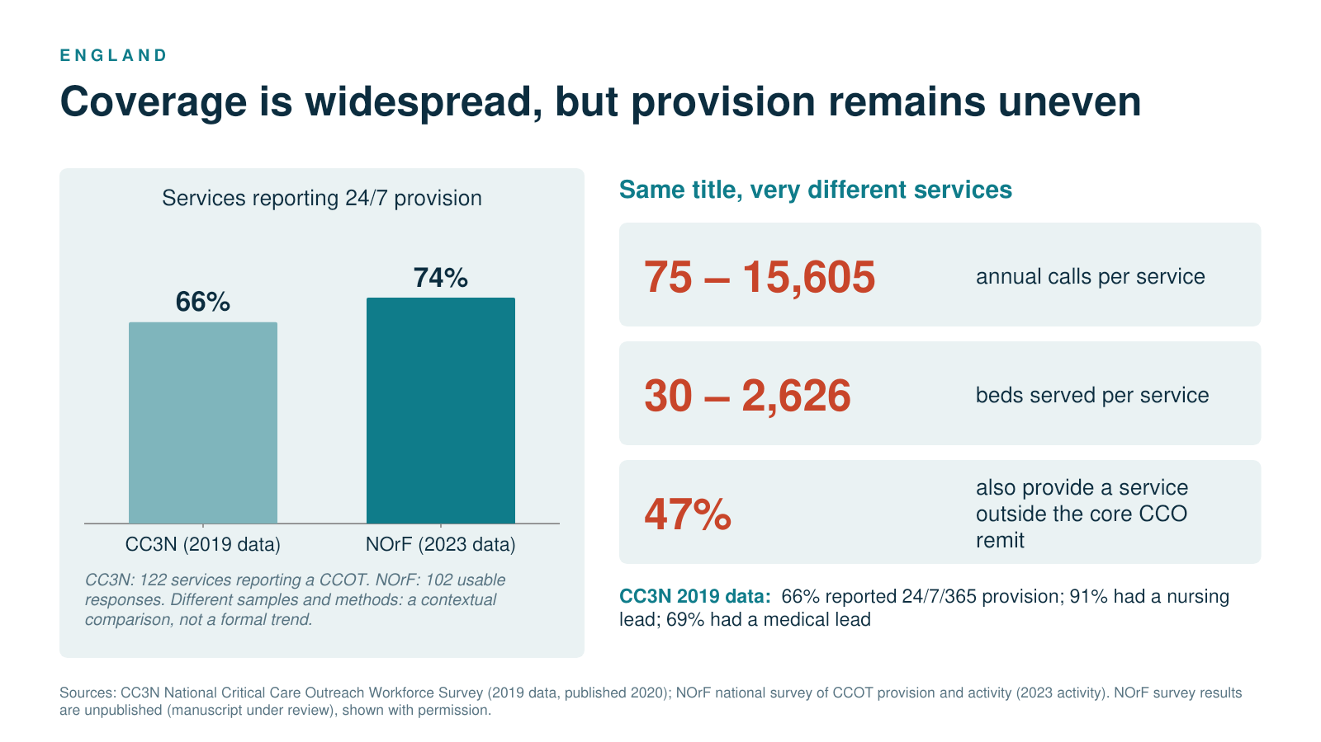
Notes:
[Target: about 1 min]
Critical Care Outreach is now widely established across England.
The CC3N survey identified 122 services. The newer NOrF survey received 102 usable responses, with 74 per cent reporting 24-hour coverage.
The variation is striking: annual activity ranged from 75 calls to more than 15,000, and beds covered from 30 to more than 2,600. Almost half also worked outside the traditional outreach remit.
The same title can therefore describe very different staffing, availability and capability. That creates a risk of unequal access to specialist deterioration care.
Transition: This matters because the role of outreach has also expanded considerably.
Sources: CC3N National Critical Care Outreach Workforce Survey (2019 data, 2020); NOrF 2023 survey manuscript (unpublished, under review).

Slide 4
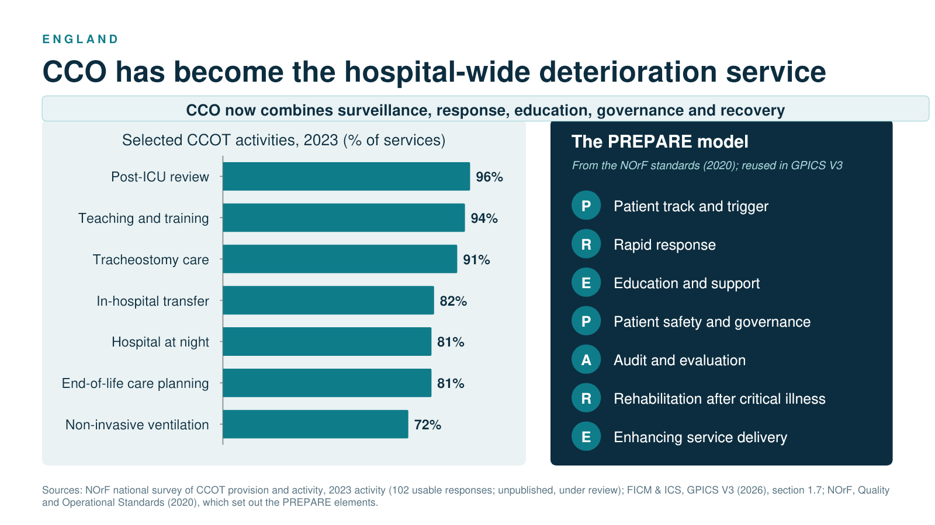
Notes:
[Target: about 1 min 10 sec]
Modern outreach is much more than an emergency response to a high NEWS2.
The NOrF survey shows teams providing post-ICU follow-up, teaching, tracheostomy support, non-invasive ventilation, hospital-at-night services and support with end-of-life decisions.
The PREPARE model reflects this breadth across detection, response, education, governance, rehabilitation and improvement.
We should increasingly describe CCO as the hospital-wide specialist service for clinical deterioration, linking surveillance with expert response across the pathway.
Transition: If CCO now works across the whole pathway, the way we identify and interpret risk must also evolve.
Sources: NOrF 2023 survey; NOrF Quality and Operational Standards (2020); GPICS V3 (2026).

Slide 5
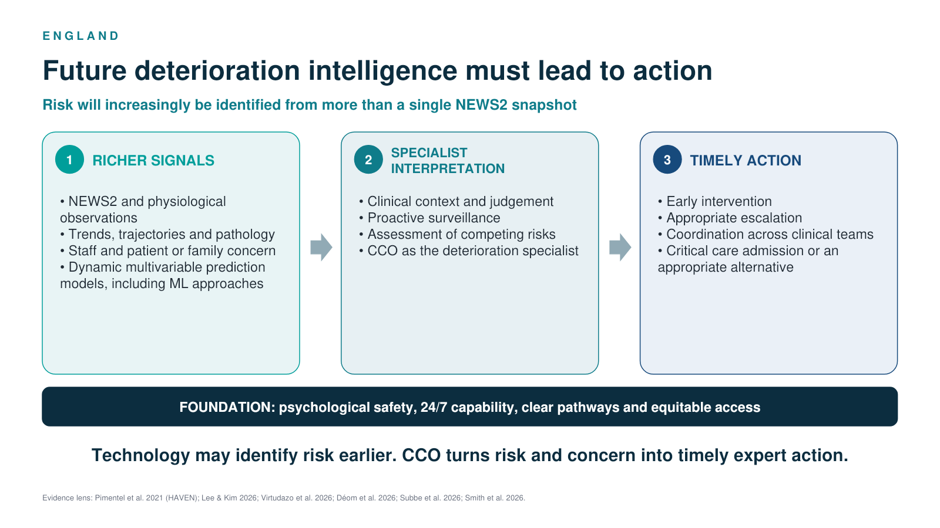
Notes:
[Target: about 1 min]
We are becoming increasingly sophisticated at identifying deterioration.
Future surveillance may move beyond a single NEWS2, combining physiological trends, pathology, clinical judgement, staff concern and the patient or family's view.
Multivariable and machine-learning models may help identify where a patient is heading, although the evidence remains emerging.
A dashboard does not improve outcomes alone. Someone must interpret the information, assess the patient and coordinate the response. CCO can convert increasingly complex information into timely clinical action.
Transition: Delivering that role requires a clearly defined specialist workforce.
Sources: Pimentel MAF et al. (2021), HAVEN; Lee S, Kim G (2026); Virtudazo MD et al. (2026); Déom N et al. (2026); Subbe et al. (2026); Smith D et al. (2026). Evidence for trajectory and machine-learning models remains emerging.

Slide 6
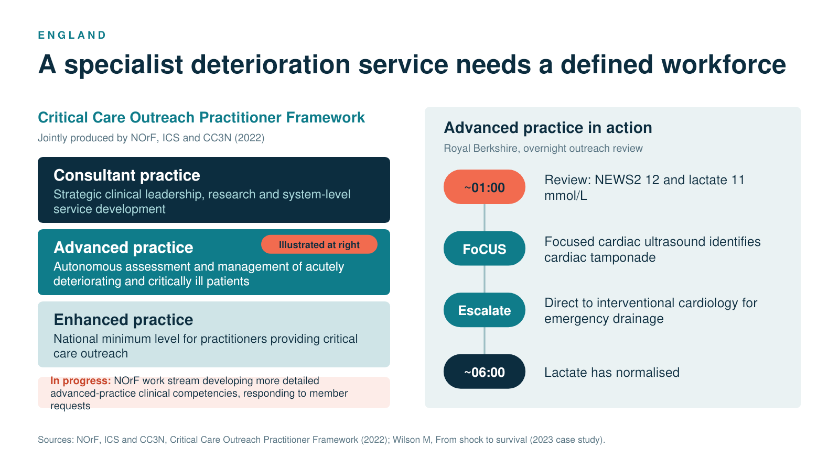
Notes:
[Target: about 1 min 20 sec]
The Critical Care Outreach Practitioner Framework, produced by NOrF, the Intensive Care Society and CC3N, describes enhanced, advanced and consultant practice.
Enhanced practice is the national minimum. Advanced practice includes autonomous assessment and management. Consultant practice adds strategic leadership, research and system development.
The Royal Berkshire case shows advanced practice in action. Overnight, a practitioner assessed a patient with a NEWS2 of 12 and lactate of 11. Focused cardiac ultrasound identified tamponade, enabling direct escalation for emergency drainage. By around six o'clock, the lactate had normalised.
The value was not ultrasound alone, but specialist assessment, interpretation, authority to escalate and coordination of definitive treatment.
Transition: England now has standards and a workforce framework. The remaining challenge is reliable and equitable implementation.
Sources: CCOP Framework (NOrF, ICS, CC3N, 2022); Wilson (2023) case study.

Slide 7
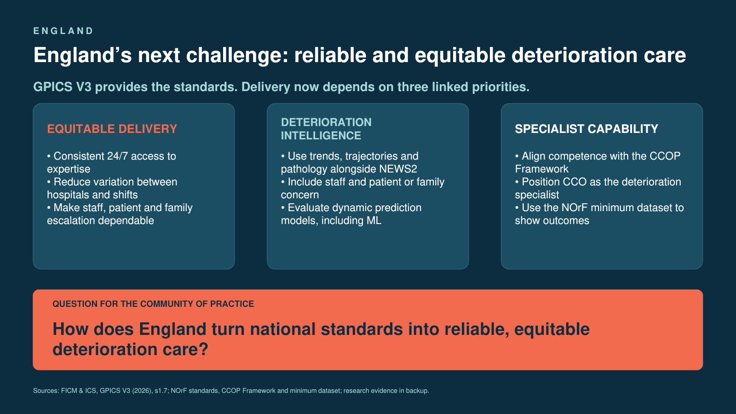
ENGLAND
GPICS V3 sets the next implementation challenge
Minimum standards
Quality recommendations
Hospital-wide detection and escalation available 24/7
Review for NEWS2 of 5 or more, a single-parameter score of 3, or any clinical concern, with access to intensive care expertise
CCOT review after ICU discharge for at least 24 hours and while the patient remains at risk
NOrF minimum dataset used in acute hospitals in England and Wales
CCOT, rapid response team or medical emergency team available 24/7
Outreach based within the intensive care directorate
Workforce competence aligned with the CCOP Framework
Patient- and carer-activated escalation, education and pathology alerts used alongside NEWS2
QUESTIONS FOR THE COMMUNITY OF PRACTICE
How does England turn national standards into equitable delivery?
Outreach teams (143 trusts) predominantly handle Martha’s Rule calls. As it extends to maternity and neonatal care, what competence and support do adult-trained teams need?
Sources: FICM & ICS, GPICS V3 (2026), section 1.7; NOrF (outreach provision and Martha’s Rule activity); DHSC press release, 24 June 2026.
Notes:
[Target: about 50 sec]
GPICS V3 provides clearer expectations, but delivery depends on three connected priorities.
First, equitable delivery: dependable access to expertise across hospitals, wards and times of day.
Second, better deterioration intelligence: NEWS2 alongside trends, pathology, clinical concern and appropriately evaluated predictive models.
Third, specialist capability: a developed outreach workforce and consistent data that demonstrate outcomes rather than simply counting activity.
The question I would carry into our Community of Practice is: How does England turn national standards into reliable, equitable deterioration care?
Sources: FICM and ICS, GPICS V3 (2026), section 1.7.

Slide 8
WELSH OUTREACH FORUM
Critical Care
Outreach
Earlier recognition.
Faster expert response.
Safer recovery.
The patient safety engine
of Welsh hospitals
Vanessa Jones
Lead Nurse, Resuscitation &
Acute Deterioration
NHS Wales • Patient safety

Slide 9

WHY OUTREACH MATTERS
02
Demand is rising faster than critical-care capacity
3.15 million population
7 health boards
2 trusts
Lowest rate of available Critical beds per population
11 outreach teams
Outreach protects scarce capacity by recognising deterioration and mobilising expert help earlier.
4–5%
A small
patient group —
but a high-stakes
system pressure.
annual growth
in critical-care demand
2003
First Outreach Team
BCUHB
2013
The Welsh Chapter evolved from NOrF
Provision of 4.75 beds per 100,000 population
Recognition
before crisis
creates options.
Source: Welsh Government Task & Finish Group on Critical Care, 2019.

Slide 10
THE VALUE OF OUTREACH
03
Outreach supports rising demand with timely review and safe step-down care
Local assurance data shows growing reach alongside strong review and recovery measures.
ANNUAL OUTREACH REFERRALS
WHAT THE SERVICE DELIVERED
87%
acute referrals responded to within target time
92%
ITU step-downs reviewed within 24 hours
96%
patients discharged from outreach alive
1 / 272
early critical-care readmissions after step-down
4,007
referrals in 2024 — 56% above 2018
10% of outreach patients were admitted to critical care — showing the service supports most patients safely outside critical care.
Source: user-provided Outreach Assurance Data, February 2025. Local service data; health-board branding removed.

Slide 11
THE CURRENT FOOTPRINT
04
Coverage is broad; service models still vary
Team numbers, sites and 24/7 provision are not yet consistent across Wales.
BETSI CADWALADR UHB
POWYS TEACHING HB
3 teams • 3 sites • 24/7
No acute outreach service as no acute services community hospital base
First CCOT established 2003
HYWEL DDA UHB
ANEURIN BEVAN UHB
2 teams • 2 sites
1 team • 3 sites
SWANSEA BAY UHB
CARDIFF AND VALE UHB
1 team • 1 site
1 team • 2 sites
The next standard is not a single team model — it is a reliable response everywhere.
CWM TAF MORGANNWG UHB
3 teams • 3 sites • 24/7
Service footprint and team counts retained from the source presentation.

Slide 12
05
BUILDING A SHARED VOICE
NOrF helped Welsh outreach teams build a stronger national voice
Representation created space to share practice, develop common expectations and support more consistent CCO services.
HOW NOrF SUPPORTED PROGRESS
2013
2020
2020–22
CONNECT TEAMS
A representative forum for collaboration and shared resources.
Welsh Chapter established
Welsh Outreach Forum established
Shared standards emerge
SHARE STANDARDS
Evidence-led standards for outreach service development.
A dedicated Welsh voice within the National Outreach Forum.
By 2020, the Welsh Outreach Forum included representation from all CCO teams in Wales.
NOrF standards and the CCOP Framework set common expectations for service and practice.
DEVELOP PRACTICE
A structured pathway supporting enhanced, advanced and consultant practice.
The opportunity now is to build on this shared platform—strengthening recognition, governance and capability across Wales.
Welsh milestones: Welsh Outreach Forum history (user-provided) | National role: NOrF | Standards: NOrF 2020; CCOP Framework 2022

Slide 13
ONE NATIONAL PATHWAY
06
Wales is standardising both the signal and the route to help
Clinical deterioration and human concern must trigger the same dependable response.
01
THE CLINICAL SIGNAL
02
THE HUMAN SIGNAL
NEWS2 • PEWS • NEWTT2 • MEWS
CALL FOR CONCERN
Standardised scores identify deterioration, trigger escalation and define the expected response.
Variation in practice was explicitly identified as a patient-safety risk.
Patients and families gain a direct route to urgent review across adult, paediatric, neonatal and maternity settings.
The operational test: rapid response, 24 hours a day.
ONE ESCALATION PATHWAY → ONE EXPECTED RESPONSE
Sources: WHC/2024/035; WHC/2025/002; WHC/2024/040; WHC/2026/001; Task & Finish Group, 2019.

Slide 14
THE WORKFORCE CHALLENGE
07
The framework is national; recognition of CCO as advanced practice is not yet consistent
A stakeholder-observed gap remains between the complexity of outreach practice and local role classification.
THE NATIONAL STANDARD
THE CCO IMPLEMENTATION GAP
HEIW Professional Framework
01
RECOGNITION
CCO can still be viewed as experienced specialist practice rather than a level of advanced practice.
Published June 2023
02
GOVERNANCE
Job descriptions, scope, credentialing, supervision and job plans need explicit alignment to the HEIW level.
Defines enhanced, advanced and consultant levels of practice.
Sets expectations for governance, education, job planning and organisational support.
Creates pathways for development, progression and retention across NHS Wales.
03
PROGRESSION
Education support and career pathways need consistent application across services and health boards.
ALIGN THE HEIW LEVEL WITH THE CCOP COMPETENCIES — RECOGNISE THE PRACTICE, NOT JUST THE JOB TITLE
Sources: HEIW Professional Framework (Jun 2023; implementation update Jun 2024); ICS/NOrF/CC3N CCOP Framework (Dec 2022). Recognition gap: stakeholder observation.

Slide 15
CHALLENGES AND FUTURE PRIORITIES
08
Priorities for outreach services across Wales
Reliable 24-hour cover, clear advanced practice pathways and shared data can support more consistent services.
01
Consistent 24-hour outreach across Wales
Fund 24-hour teams with shared competencies and clear referral pathways for timely specialist support.
02
Advanced practice development
Define recognition and career pathways for advanced practice, supported by consistent education and governance.
03
Shared national data
Use a shared dataset to compare services, understand variation and guide improvements in practice.
Aim: more equitable access, earlier escalation and reliable support for ward staff.
Future priorities: Welsh Outreach Forum.
Notes:
Delivery considerations: agree an all-Wales service standard and assess local demand. Fund sustainable rotas with cover for leave and sickness. Provide supervised competency development and clear referral, escalation and handover arrangements. Monitor coverage gaps and response times alongside patient outcomes.
Benefits shown are intended service improvements, not proven reductions in mortality or ICU admissions. Evidence for outreach effects on mortality and cardiac arrest remains inconclusive.
[Sources]
National Outreach Forum. Quality and Operational Standards for the Provision of Critical Care Outreach Services (2020). https://www.wyccn.org/uploads/6/5/1/9/65199375/norf_operational_standards_2020.pdf
Critical Care Outreach Practitioner Framework (2022). https://ics.ac.uk/resource/ccopf.html
NICE CG50. Acutely ill adults in hospital: recognising and responding to deterioration. https://www.nice.org.uk/guidance/cg50/chapter/Recommendations
HEIW. Professional Framework for Enhanced, Advanced and Consultant Clinical Practice in Wales (2023). https://heiw.nhs.wales/workforce/workforce-transformation/workforce-development/professional-framework-for-enhanced-advanced-and-consultant-clinical-practice/
Trenchard-Turner et al. Critical care outreach teams: a service without walls (2023). https://link.springer.com/content/pdf/10.1007/s00134-023-07021-y.pdf
[/Sources]

Slide 16

CRITICAL CARE OUTREACH IN IRELAND
From local innovation to a national model of Advanced Practice
2015 → 2026
Advanced Practice • Core competencies • National dataset • Benchmarking
The Irish story is not only the growth of Outreach —
it is how Advanced Practice became its professional framework.
1 | BACCN × NOrF • Belfast 2026

Slide 17
01 · FROM FOUNDATIONS TO ADVANCED PRACTICE
Ireland did not start from zero
National policy created the direction. Advanced Practice created a framework for delivery.
2009
PROSPECTUS
THE IRISH DIFFERENCE
Outreach identified within safe,
responsive critical care.
Advanced Practice became the engine of Outreach
PILLAR 1: CLINICAL
PRACTICE
PILLAR 2: LEADERSHIP &
MANAGEMENT
PILLAR 3: EDUCATION
PILLAR 4: RESEARCH
2014
HSE MODEL OF CARE
Role model
Educator/
Mentor
Address own learning needs, & professional development
Research & develop evidence-based strategies
Evaluate & audit clinical practice
Autonomous assessment
Clinical reasoning
Advanced interventions
MDT leadership
Clinical governance
Practice development
Deterioration, escalation,
education & governance.
2015
FIRST ANP-LED CCOT
Specialist critical care expertise
brought to the patient.
ADVANCED PRACTICE = A PROFESSIONAL FRAMEWORK FOR AUTONOMOUS OUTREACH
500 hours of clinical advanced supervised practice in addition to 96 hours of prescribing practice with a MSc
ADVANCED PRACTICE = A PROFESSIONAL FRAMEWORK FOR AUTONOMOUS OUTREACH
500 hours of clinical advanced supervised practice in addition to 96 hours of prescribing practice with a MSc
2 | BACCN × NOrF • Belfast 2026

Slide 18
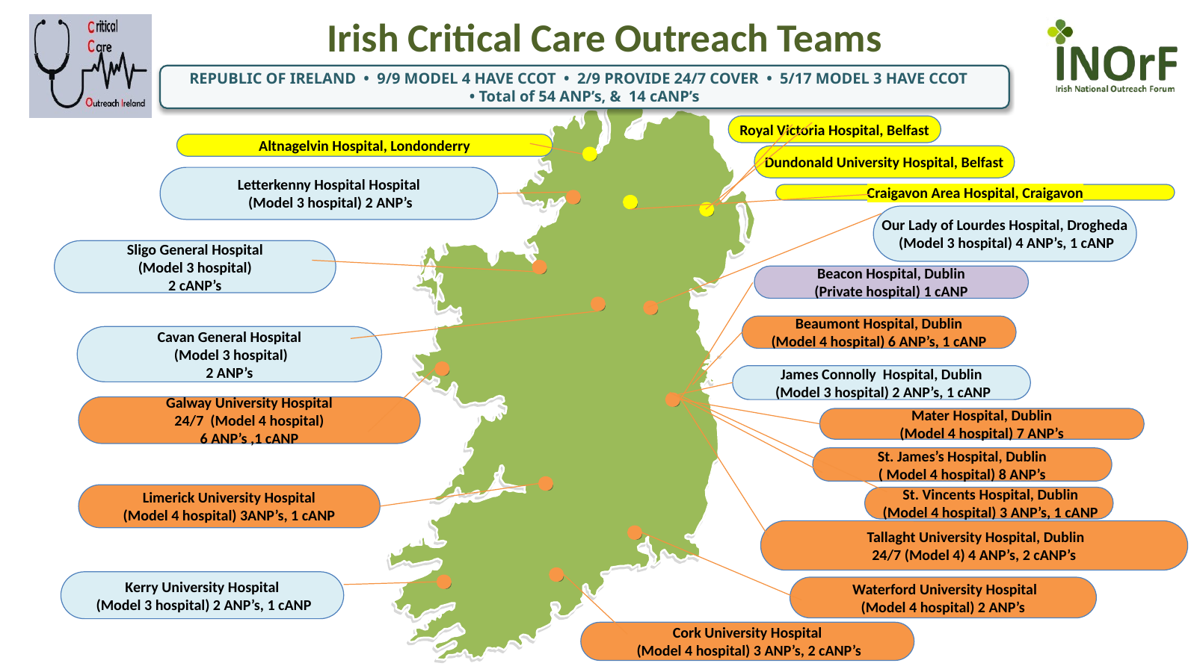
02 · FROM LOCAL INNOVATION TO A NATIONAL COMMUNITY
A decade of connection, standards and shared learning
Services evolved locally — the next phase is national consistency without enforced uniformity.
2015
2019+
2022+
2024–26
FIRST ANP-LED
SERVICE
GROWING
LOCAL MODELS
IRISH NETWORK
& NOrF
COMPETENCIES
+ DATASET
9/9
2/9
5/17
54 + 14
MODEL 4 HAVE CCOT
PROVIDE 24/7
MODEL 3 HAVE CCOT
ANP + cANP
NOrF · CONNECTION
A bridge to the wider UK & Welsh Critical Care Outreach community — sharing experience, learning and professional collaboration.
ADVANCED PRACTICE
↓ SHARED MINIMUM COMPETENCIES + NATIONAL DATASET ↓
BENCHMARK → LEARN → DEVELOP
A shared national framework — consistent standards, flexible local delivery.
3 | BACCN × NOrF • Belfast 2026

Slide 19
03 · PROGRESS BRINGS NEW CHALLENGES
Growth creates a different set of questions
The challenge is no longer simply establishing Outreach — it is sustaining, measuring and developing it.
WORKFORCE & CAPACITY
FUNDING & RESOURCES
Recruitment • retention • 24/7 models
Time for education, governance & QI
Sustainable staffing and infrastructure
Different capacity between hospitals
SUSTAINABLE
NATIONAL
DEVELOPMENT
DATA & DIGITAL
VARIATION IN MODELS
Consistent capture across systems
Reliable national benchmarking
Hours • staffing • referral criteria • scope
Core standards + local flexibility
DEMONSTRATING IMPACT
Use consistent national data to examine patient pathways, outcomes and variation between services
“You can't benchmark what you can't consistently measure.”
4 | BACCN × NOrF • Belfast 2026

Slide 20
04 · THE NEXT CHAPTER
Ireland is moving from growth → maturity
A national model built on Advanced Practice, shared standards and evidence of impact.
01
02
03
04
STANDARDISE
BENCHMARK
DEVELOP
EXPAND
Core competencies
& governance
National dataset
& meaningful measures
ANP & multidisciplinary
workforce
Sustainable,
equitable access
ADVANCED PRACTICE → SHARED STANDARDS → BENCHMARKING → IMPACT
Not identical services — consistent standards, evidence-informed development and equitable access.
From local innovation to a connected, measurable national model of Critical Care Outreach.
5 | BACCN × NOrF • Belfast 2026

Slide 21
Ayako Noguchi, Institute of Science Tokyo
A Japanese perspective for the NOrF State of the Nations session
Critical Care Outreach in Japan
From Response to Relationship: Building Person-Centred Escalation
RRS adoption is increasing,
but CCO remains diverse, locally defined, and poorly visible.
Since 2022, an RRS has been included in the facility requirements for the Acute Care Enhancement Add-on
Number of Japanese
CCO-related reports
Total number
92
2022
66.5%
2023
72.8%
2024
82.0%
RRS adopted…
(n = 275)
Only 6.7% of RRS-adopting hospitals considered their system established
CCO findings were not routinely reported separately
Most were domestic conference abstracts in Japanese
RRS survey by Japan Society of Intensive Care Medicine, 2024
Notes:
Good morning. I am Ayako Noguchi from the Institute of Science Tokyo.
I would like to share one perspective from Japan.
CCO practice remains diverse and poorly visible, even as RRS adoption is increasing.
Since 2022, RRS has been included in the facility requirements for the Acute Care Enhancement Add-on. In the 2024 survey by the Japan Society of Intensive Care Medicine, RRS adoption increased from 66.5 percent in 2022 to 82 percent in 2024.
However, only 6.7 percent of RRS-adopting hospitals considered their system established. CCO has been surveyed, but its findings are not routinely reported separately.
I mapped Japanese CCO-related reports and identified 92; most were domestic conference abstracts in Japanese. The number increased after the 2022 reimbursement reform.
This suggests that CCO practice may be developing faster than it is being described or evaluated.
So, what does CCO delivery actually look like in Japan?

Slide 22
CCO Practice Is Diverse in Japan
CCO delivery remains diverse, with no single standardised national model.
Workforce models, roles, and education vary across organisations in Japan.
 | Post-ICU follow-up | EWS-triggered | Proactive ward rounding | RRT/MET-integrated
Target | Patients discharged from ICU/PICU | Patients identified as high risk by EWS | General ward patients | Deteriorating patients
Team | ICU/RRT | Critical care nurse ± physician | Critical care nurse | RRT/MET
How? | Scheduled review | Proactive review | Regular rounds | Escalation + follow-up
Illustrative implementation patterns identified through targeted literature mapping—not a national classification or prevalence estimate.
Rapid response team (RRT) / medical emergency team (MET)
Notes:
CCO delivery remains diverse, with no single standardised national model.
To better understand this diversity, I mapped Japanese reports using CCO-, CCOT-, and CCOS-related terms. The four patterns shown here are illustrative findings from targeted literature mapping. They are not a national classification and do not estimate prevalence.
Four broad patterns emerged: post-ICU follow-up, EWS-triggered review, proactive ward rounding, and RRT- or MET-integrated models.
As the table shows, these models differ in their target patients, the teams involved, and how outreach is delivered. Workforce models, roles, and education also vary across organisations.
Rather than presenting a single Japanese model, I would now like to share two local examples that illustrate how our practice has evolved—from automated EWS to shared review.

Slide 23
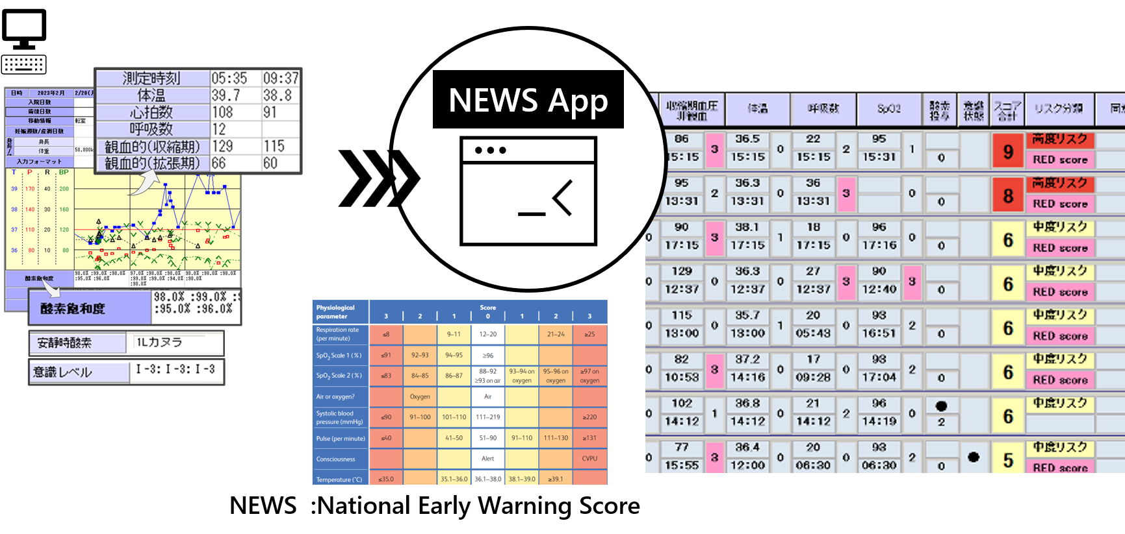
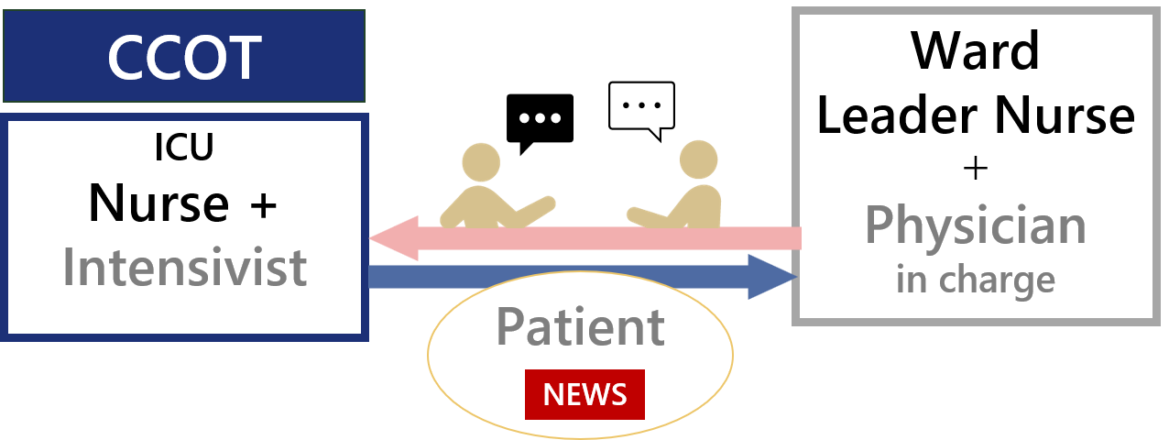
Local Examples: Empowering nurses for person-centred CCO
From automated EWS to shared review
University Hospital, Kyoto Prefectural University of Medicine
2019–2020 — creating the capability
Institution of Science Tokyo Hospital
2021 onwards — changing how it is used
A Nurse-Led CCO Model Using Automated EWS
NEWS embedded in proactive CCOT rounds
Interpreting changes in vital signs together
Encouraging nurses to voice concerns
Sharing patient and ward context
NEWS App
Royal College of Physicians. NEWS2. 2017.
Noguchi et al. Heliyon. 2023;9:e17155.
NEWS App
2019–2020
Since 2021
NEWS was not a strict numeric trigger. It was used as a prompt for shared review.
Notes:
These two local examples illustrate how my practice has evolved—from automated EWS to shared review.
In Kyoto, between 2019 and 2020, we created an automated NEWS tool from the ground up, because manual calculation and checking made routine use difficult in a busy ward.
The tool supported a nurse-led CCO model: automated screening, bedside assessment by a critical-care nurse, ward-staff support, and escalation when needed. It did not replace clinical judgement; it made early-warning information usable in everyday practice.
At the Institute of Science Tokyo Hospital, the next question was not only whether NEWS could be calculated, but how it should be used. We embedded it in proactive CCOT rounds—not as a strict numeric trigger, but as a prompt for shared review.
During these rounds, we interpret changes in vital signs together, encourage nurses to voice concerns, and share patient and ward context.
In this way, digital support made detection more feasible, while shared review made escalation more relational.

Slide 24
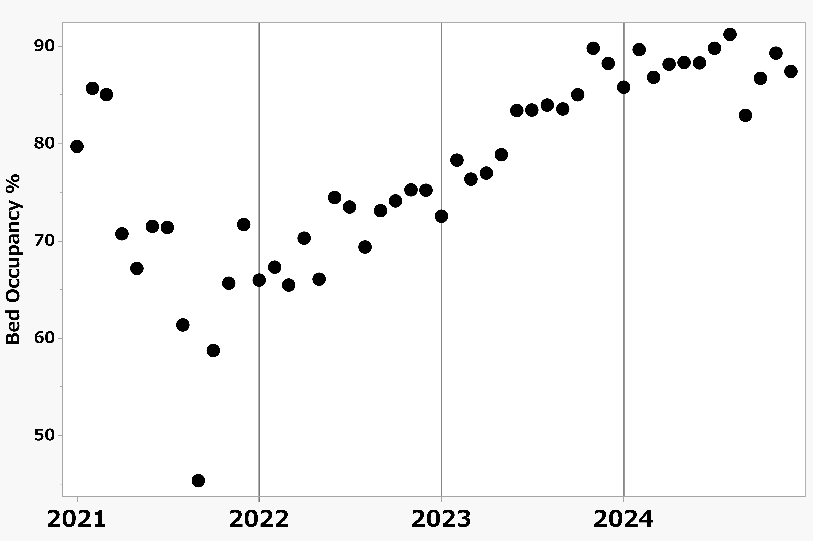
Evaluating a CCO Practice:
Can Shared Review Help Sustain Escalation Under Operational Pressure?
Nurse-triggered RRS calls were above pre-implementation levels across follow-up
Not statistically significant.
Observational longitudinal implementation study, 2021–2024
Implementation: NEWS embedded in proactive CCOT rounds
Context: rising hospital bed occupancy after COVID-19
Nurse-triggered RRS calls (vs pre-implementation)
IRR (95% confidence intervals)
0–12 months 1.62
12–24 months 1.46
24–36 months 2.15
(0.78–3.36)
(0.70–3.03)
(0.91–5.79)
All estimates were above 1.0, but confidence intervals crossed 1.0.
Observational data: association observed; causality cannot be inferred.
Unpublished data; manuscript under review
Notes:
This led us to ask whether shared review could be sustained under operational pressure.
We evaluated this question in an observational study from 2021 to 2024, during a period when hospital bed occupancy increased rapidly after COVID-19.
Despite this pressure, escalation-related processes remained broadly stable, and nurse-triggered RRS calls showed a positive, though non-significant, trend across follow-up.
These observational findings cannot establish causality. However, they suggest that embedding NEWS in proactive CCOT rounds may help sustain escalation behaviours.
Most importantly, evaluation should capture not only clinical outcomes, but also whether concerns are recognised, voiced, heard, and acted upon.

Slide 25
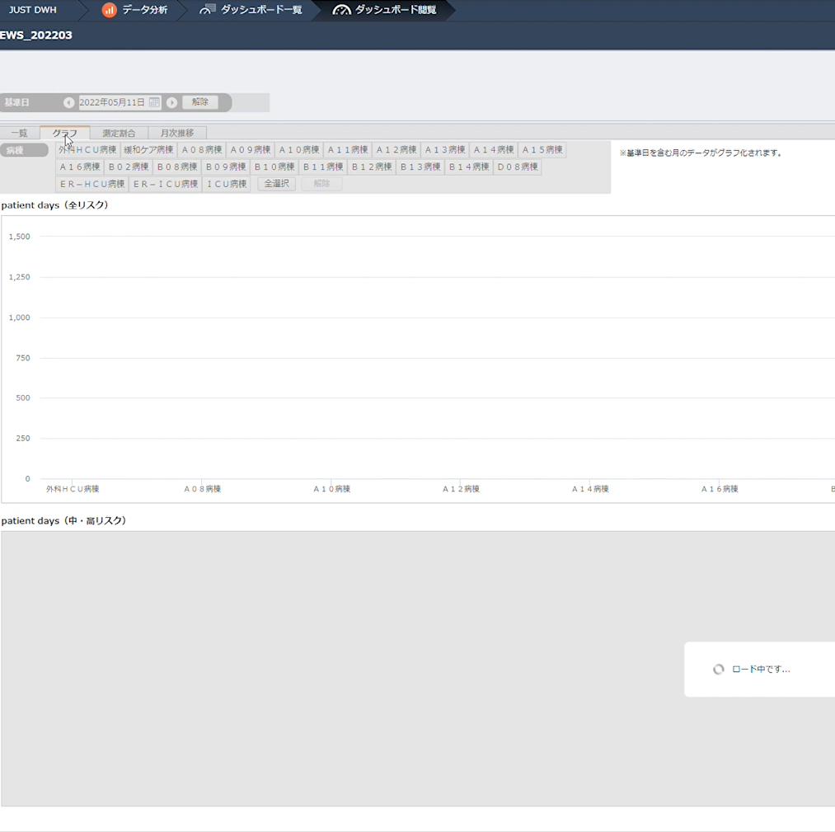

From response to relationship
Sustainable escalation requires
data, digital support, and a culture
in which every concern can be voiced.
Dialogue builds the relationships
that make escalation possible.
ISCT dashboard: NEWS and the proportion of patients with respiratory-rate measurements, by ward and month
    How can we build and evaluate CCO systems that use data and digital support
    while ensuring that every concern can be voiced?
Notes:
Sustainable escalation requires data, digital support, and a culture in which every concern can be voiced.
This dashboard shows respiratory-rate measurement and NEWS-identified high-risk patients by month, ward, and year. I will let it run rather than explain it in detail.
However, data alone do not escalate care. Dialogue builds the relationships that make escalation possible.
For me, person-centred CCO means using digital tools to support—not replace—clinical judgement, shared interpretation, and the confidence to voice concerns.
So I would like to leave the Community of Practice with one question:
How can we build and evaluate CCO systems that use data and digital support while ensuring that every concern can be voiced?
Thank you.

Slide 26
STATE OF THE NATIONS | COMMON THEMES
Four nations, different journeys, shared challenges
Drawn from the four national presentations. Each card shows where the theme appeared.
1
Growth, but uneven provision
2
Advanced practice as the professional framework
ENGLAND
WALES
IRELAND
JAPAN
ENGLAND
WALES
IRELAND
JAPAN
England: 75 to 15,605 calls a year per service; about three-quarters report 24/7 cover
Wales: team models vary; not all acute sites have outreach teams
Ireland: 24/7 provision and CCOT coverage still partial across hospital models
Japan: RRS adopted by 82% of responding hospitals, but only 6.7% see theirs as established
England: CCOP Framework (2022); NOrF work stream adding advanced-practice detail
Wales: HEIW framework in place, but CCO not consistently recognised as advanced practice
Ireland: ANP-led outreach since 2015, built on the four pillars
Japan: workforce models, roles and education vary between organisations
3
Data, benchmarking and evidence of impact
4
Patient, family and staff voice in escalation
ENGLAND
WALES
IRELAND
JAPAN
ENGLAND
WALES
JAPAN
England and Wales: NOrF minimum dataset is now a GPICS V3 minimum standard
Wales and Ireland: a national dataset is a named priority
Ireland: "You can't benchmark what you can't consistently measure"
Japan: CCO activity is growing faster than it is being described or evaluated
England: Martha's Rule, now extending to maternity and neonatal care
Wales: Call for Concern across adult, paediatric, neonatal and maternity settings
Japan: shared review so that every concern, including nurses', can be voiced
Notes:
[Chair, about 2 minutes] Draft summary drawn from the four national presentations; check wording with each presenter at the 5 October review.
Four themes came through all of the talks. First, outreach has grown everywhere, but provision is uneven: in England the same title covers services from 75 to over 15,000 calls a year; Wales still has a health board with no acute outreach service; in Ireland coverage and 24/7 provision are still partial; and in Japan RRS adoption is high but few hospitals consider their system established.
Second, advanced practice is increasingly the professional framework for outreach, but recognition and detail vary: the CCOP Framework and NOrF work stream in England, the HEIW recognition gap in Wales, ANP-led outreach in Ireland, and varied roles and education in Japan.
Third, data. Every nation wants to benchmark and show impact, and a shared dataset keeps coming up.
Fourth, voice: Martha's Rule, Call for Concern, and in Japan, making sure every concern can be voiced.
CHECK: Ireland figures (2/9 provide 24/7; 5/17 Model 3 hospitals have CCOT) are summarised from Siobhan's slide 3; confirm the wording with her.

Slide 27
CARRYING FORWARD TO THE COMMUNITY OF PRACTICE
Questions to take into the closing session
ENGLAND
WALES
IRELAND
JAPAN
Mark Wilson
Vanessa Jones
Siobhan Tierney-Pyke
Ayako Noguchi
How does England turn national standards into equitable delivery?
How do we recognise the practice, not just the job title, by aligning HEIW advanced-practice levels with the CCOP competencies?
How do we reach consistent standards and a national dataset without enforcing identical services?
How can we build and evaluate CCO systems that use data and digital support while ensuring that every concern can be voiced?
THE SHARED QUESTION
How do we show what outreach achieves for patients, beyond activity counts?
BACCN × NOrF • Community of Practice: Day 2, final session
Notes:
[Chair, about 2 to 3 minutes, then close]
England and Japan questions are taken word for word from the presenters' final slides.
DRAFT: the Wales and Ireland questions are proposed from their closing slides (Wales slide 7 banner; Ireland slides 3 and 5). Vanessa and Siobhan to confirm or replace at the 5 October review.
The shared question on impact runs through Wales (research and evaluation priority), Ireland (demonstrating impact; you cannot benchmark what you cannot consistently measure), Japan (evaluating shared review under pressure) and England (GPICS V3 and the NOrF minimum dataset). It moves the discussion from counting activity to showing value for patients.
England's second question, on Martha's Rule extending to maternity and neonatal care, stays on Mark's slide 5 and can be raised in discussion.

Slide 28
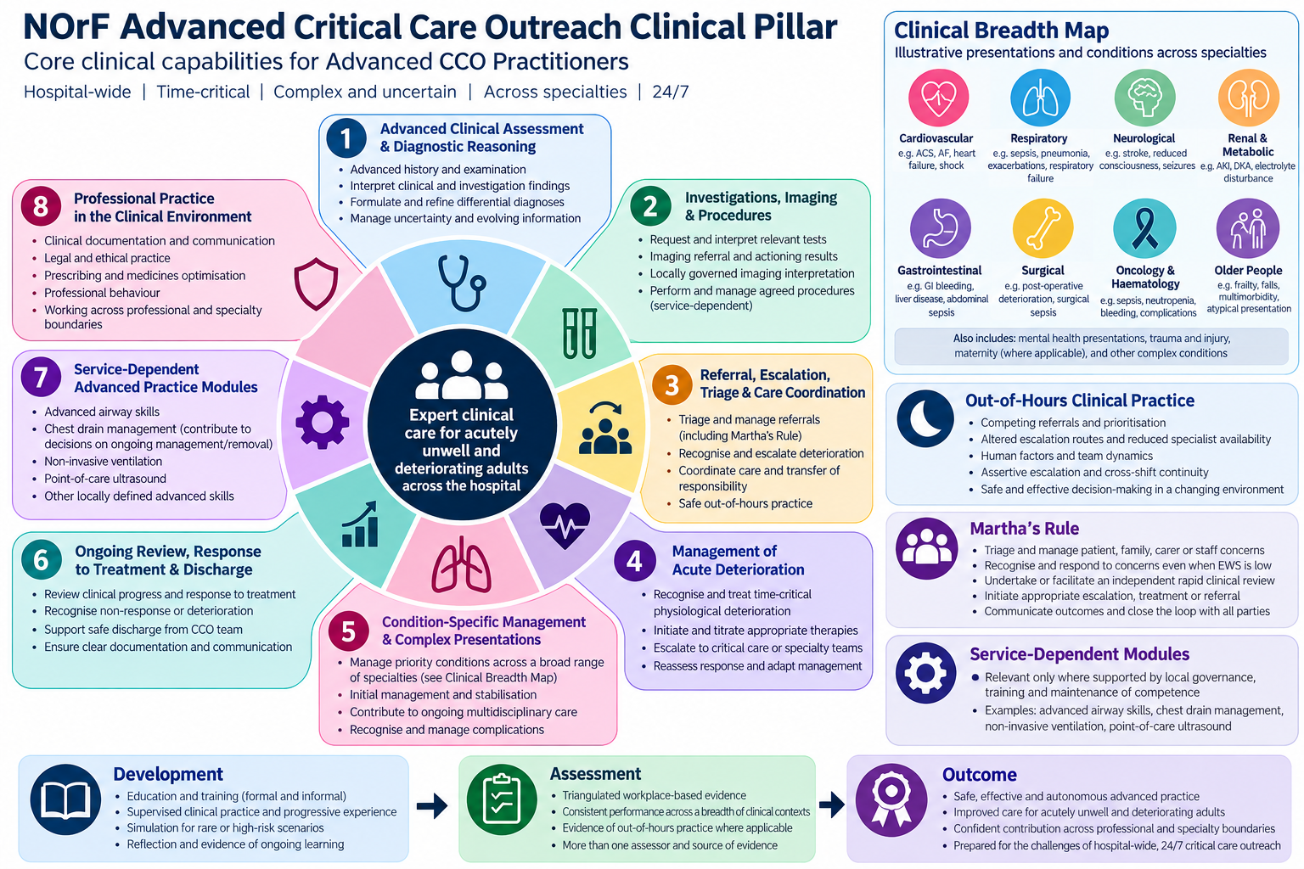
SPARE (NOT PRESENTED) | NOrF advanced CCO practice: clinical pillar, draft V1
Notes:
Hidden spare slide, for questions only. Draft V1 of the clinical pillar infographic from the NOrF advanced practice pillar development group. Too dense to read from the back of a room.

Slide 29
ENGLAND | BACKUP (NOT PRESENTED)
References
Department of Health (2000). Comprehensive Critical Care.
UK non-medical prescribing legislation and implementation guidance, 2003–06 (incl. SI 2006/913).
NICE (2007). CG50: Acutely ill adults in hospital: recognising and responding to deterioration.
Odell M, Gerber K, Gager M (2010). Call 4 Concern: patient and relative activated critical care outreach. Br J Nurs 19(22):1390–5.
Odell M (2019). Patient- and relative-activated critical care outreach: a 7-year service review. Br J Nurs 28:116–21.
Royal College of Physicians. National Early Warning Score (NEWS, 2012); NEWS2 (2017).
CC3N (2020). National Critical Care Outreach Workforce Survey (2019 data).
NOrF (2020). Quality and Operational Standards for the Provision of Critical Care Outreach Services (source of the PREPARE elements).
Subbe CP et al. (2019). Quality metrics for the evaluation of Rapid Response Systems: proceedings from the third international consensus conference on Rapid Response Systems (International Society for Rapid Response Systems). Resuscitation 141:1-12.
NOrF, ICS and CC3N (2022). Critical Care Outreach Practitioner Framework, with enhanced, advanced and consultant appendices.
NOrF (2023). Minimum dataset and national survey of CCOT provision and activity (manuscript unpublished, under review).
Trenchard-Turner, Desai and Metaxa (2023). Critical care outreach teams: a service without walls. Intensive Care Med 49:572–4.
Honarmand K et al. (2024). Society of Critical Care Medicine guidelines on recognizing and responding to clinical deterioration outside the ICU: 2023. Crit Care Med 52(2).
Welch et al. (2025). Martha’s Rule.
FICM and ICS (2026). Guidelines for the Provision of Intensive Care Services, Version 3, section 1.7.
Royal Cornwall Hospitals. Critical Care Outreach operational policy.
Wilson M (2023). From shock to survival (case study: focused cardiac ultrasound and cardiac tamponade).
Department of Health and Social Care (2026). Martha’s Rule extended to all maternity services (press release, 24 June 2026).
NHS England. Martha’s Rule (patient safety programme page).
Notes:
Backup slide, hidden in slide show mode (not presented). Reinstate or move to the shared reference list when the four national sections are merged.
Odell (2019 and 2010), Honarmand (2024) and Trenchard-Turner (2023) details were checked against other papers' reference lists. Author initials and the full title for Welch et al. (2025) were not in the source notes, so check that one against the original before circulating.

