Slide 1
Enhanced Maternal Care
Danni Gupta, Consultant Midwife

Slide 2
Content
Background
Common emergencies in Obstetrics
Structure of EMC

Slide 3
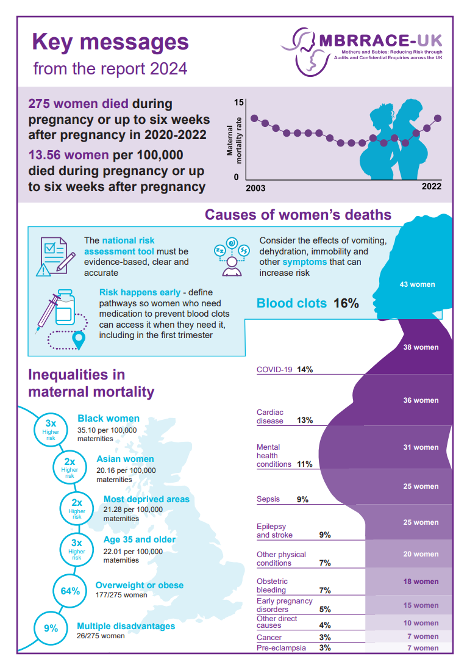
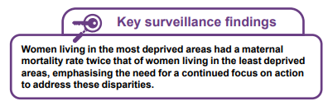
Why?
Notes:
Every three years MBRRACE (Mothers and Babies: Reducing Risk through Audit and Confidential Enquiries in the UK) produce a report about maternal deaths
2024 report featured maternal deaths from COVID19.
Maternal suicide remains the leading direct (pregnancy-related) cause of death from six weeks to 1 year postnatal.
There was a distinct rise in the number of deaths from women living in the most deprived areas, irrespective of ethnicity. We see this locally too – 0.5% of our pregnant population live in the most deprived areas of Bucks, yet account for almost 50% of our stillbirths and neonatal deaths.
Local service provision therefore needs to provide better continuity of care, more accessible care and greater joined up working with other services (health visiting, sexual health, perinatal mental health etc)

Slide 4
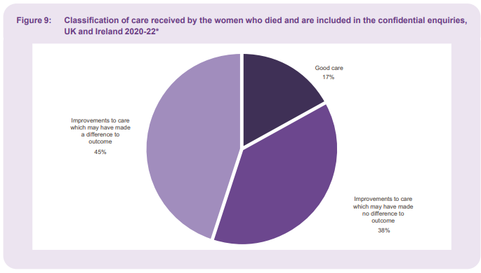
MBRRACE-UK
Notes:
We know that improvements can be made in care. In 45% of cases, if care had been different, there may have been a different outcome to the situation. Which is why we're here today. By expanding the MDT to include CCOT, we are able to provide a greater breadth of knowledge in caring for these patients.

Slide 5
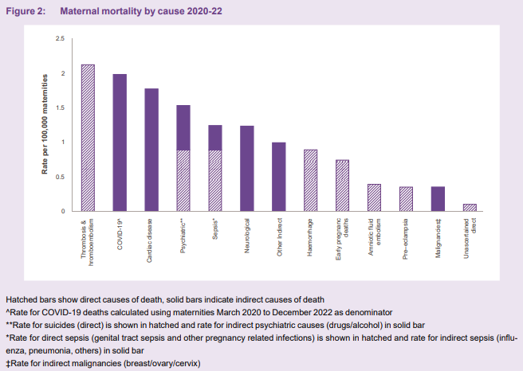
MBRRACE-UK
10% of all maternal deaths
Notes:
During 2020-22, 43 women died from a blood clot and is the leading direct cause of death.
25 women died from sepsis, representing 9% of maternal deaths; approximately half of deaths were related genital tract and pregnancy related conditions, and the other half of women died from sepsis associated with other infections not directly linked to pregnancy e.g Influenza, pneumonia and others.

Slide 6
Midwives
Experts in ‘normal’
Advocate for women and families
Not always from a nursing background
Evolving role

Slide 7
VTE

Slide 8
Why is this important?
VTE is the leading cause of death for pregnant and postnatal women
Notes:
VTE is the leading direct cause of maternal deaths in 2020-22.
45 women died of a blood clot during pregnancy or up to 6 weeks postnatal. A further 18 died between 6 weeks and 1 year postnatal. For these 62 women, their care was reviewed and opportunities to improve care were identified in 91% of cases, and in 65% of cases, may have led to a different outcome.
Pertinent to you as CCOT members, 1:4 of the women who died were in their first trimester. This means they may not have seen their midwife, an obstetrician if relevant, or understand the risks.

Slide 9
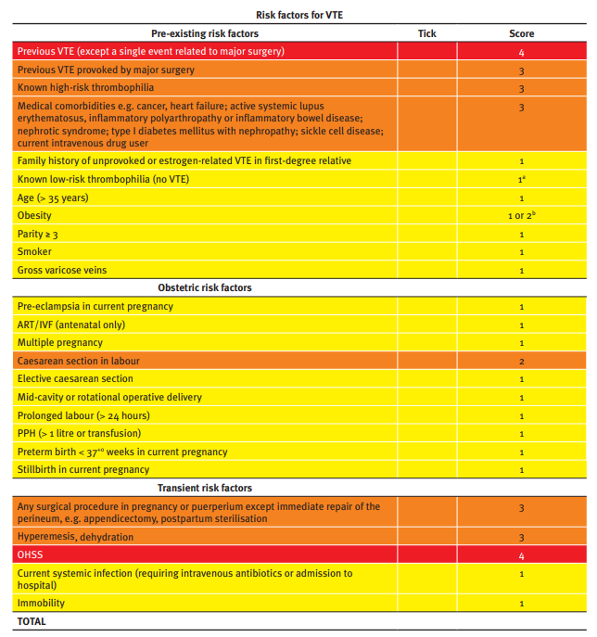
VTE
Reducing the Risk of Thrombosis and Embolism during Pregnancy and the Puerperium (RCOG Green-top Guideline No. 37a)
Notes:
All hospitals should have a bespoke VTE assessment tool based on the RCOG tool. These should be used from the start of pregnancy and will be completed by the booking midwife, usually at around 8-10 weeks.

Slide 10
VTE
Reducing the Risk of Thrombosis and Embolism during Pregnancy and the Puerperium (RCOG Green-top Guideline No. 37a)
Notes:
There are several additional risk factors that need to be considered in pregnancy which are included

Slide 11
VTE
Reducing the Risk of Thrombosis and Embolism during Pregnancy and the Puerperium (RCOG Green-top Guideline No. 37a)
Notes:
And also a few transient risk factors that you should be aware of. For CCOT, these are especially important if reviewing a patient in A&E in early pregnancy who may not have yet seen a midwife. Being aware of these if you are called to a collapsed patient in A&E may help support with the differential diagnosis and could make the difference. This is the case for one of the 62 women who died.

Slide 12
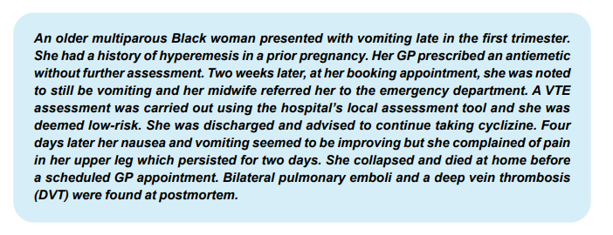
VTE
MBRRACE, 2024
Notes:
There were several missed opportunities to identify the risk factors which could have made a difference to this patient.

Slide 13
Sepsis
Notes:
Maternal sepsis is unique because of physiology of pregnancy, which may confuse the clinical presentation and adversely affect the outcome of sepsis.

Slide 14
Maternal sepsis
The onset of life-threatening sepsis in pregnancy or the puerperium can be insidious, with extremely rapid clinical deterioration, particularly where it is due to Group A Strep infection
In many of the deaths, women had a short duration of illness, and in some cases were moribund by the time they presented to hospital
Notes:
There was a concerning increase in maternal deaths due to sepsis; in the 2006–08 Confidential Enquiry into Maternal Deaths, almost a quarter of all maternal deaths were due to sepsis: the highest reported mortality rate due to genital tract sepsis for 20 years. many of these were due to Group A Streptococcus. Pregnant women compensate extremely well and often it’s been transmitted from a child having brought it home from nursery.
Thankfully, death rates from maternal sepsis have reduced since then, although sepsis overall, remains a leading contributor to maternal mortality and is also responsible for significant maternal morbidity.

Slide 15
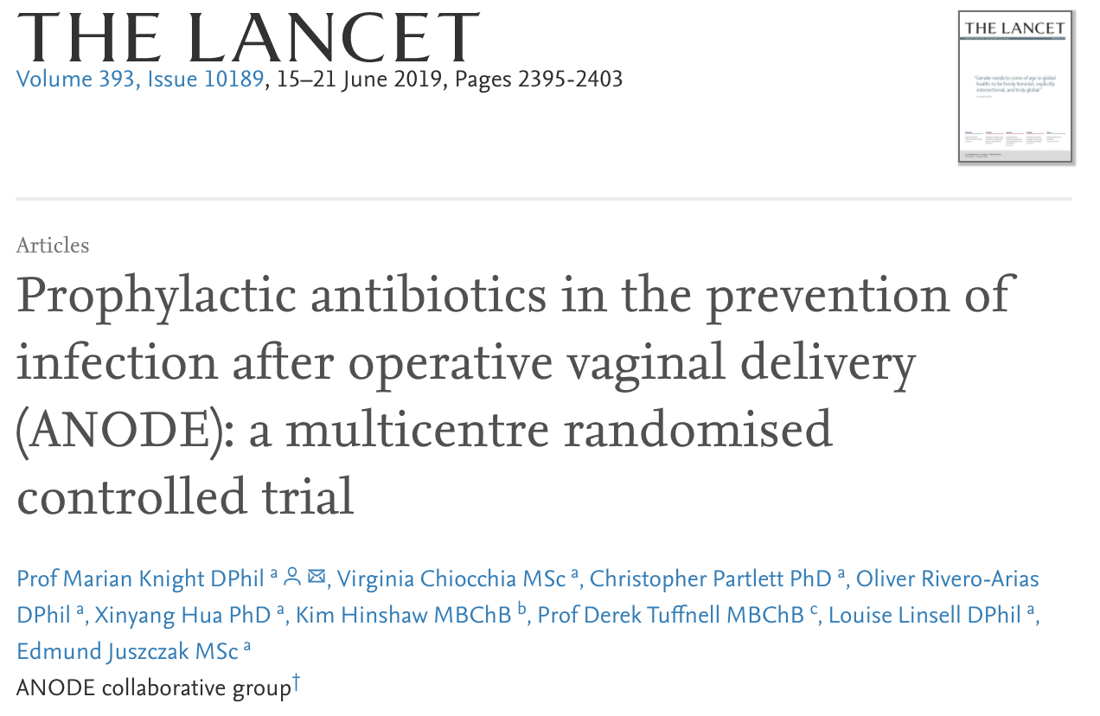
Prevention of maternal sepsis
Sepsis prevention is the primary objective and currently antenatal screening is offered nationally in the UK for asymptomatic bacteriuria
Antibiotic prophylaxis use during caesarean section has significantly reduced the incidence of febrile morbidity, wound infection, endometritis and other serious infection‐related complications (Recommended by NICE Guideline)
Prophylactic antibiotics to prevent infection following assisted vaginal birth, demonstrated a 56% reduction in confirmed maternal infection with one dose administered IV within 3 hours after Birth (ANODE Study)
Notes:
ANODE Study: Knight M, Chiocchia V, Partlett C, Rivero‐Arias O, Hua X, Hinshaw K, et al. Prophylactic antibiotics in the prevention of infection after operative vaginal delivery (ANODE): a multicentre randomised controlled trial. Lancet 2019;393(10189):2395–403.

Slide 16
Physiological changes in pregnancy
Increased heart rate (+10-20 bpm) and cardiac output
Increased oxygen requirement therefore increased resp rate
Hypotension
Notes:
HR – not abnormal up to 100bpm
Resp rate normal up to 20.
Hypotension – especially in the 2nd trimester, systolic can be down to 90 and still be normal
Womens bodies are amazing, but these are the changes that can occur in sepsis which can make it hard to spot.

Slide 17
MBRRACE-UK: recognising sepsis
Clinical observations (RR, HR, BP, SpO2 and temperature) should be taken early and regularly
Plotting clinical observations on a MOEWS chart can help in the early recognition of sepsis
Use a maternity specific sepsis six tool
Reduced or altered conscious level in a pregnant/postpartum woman:
This is not an early warning sign: it is a red flag indicating established illness
Notes:
The MBRRACE-UK report highlights the importance of regular full clinical observations in detecting early deterioration in sepsis. Vital signs should also be checked in the community and abnormal observations should prompt early referral.
Observations should always be charted on an early warning chart modified for maternity care – which helps to trigger an appropriate response by the clinical team.

Slide 18
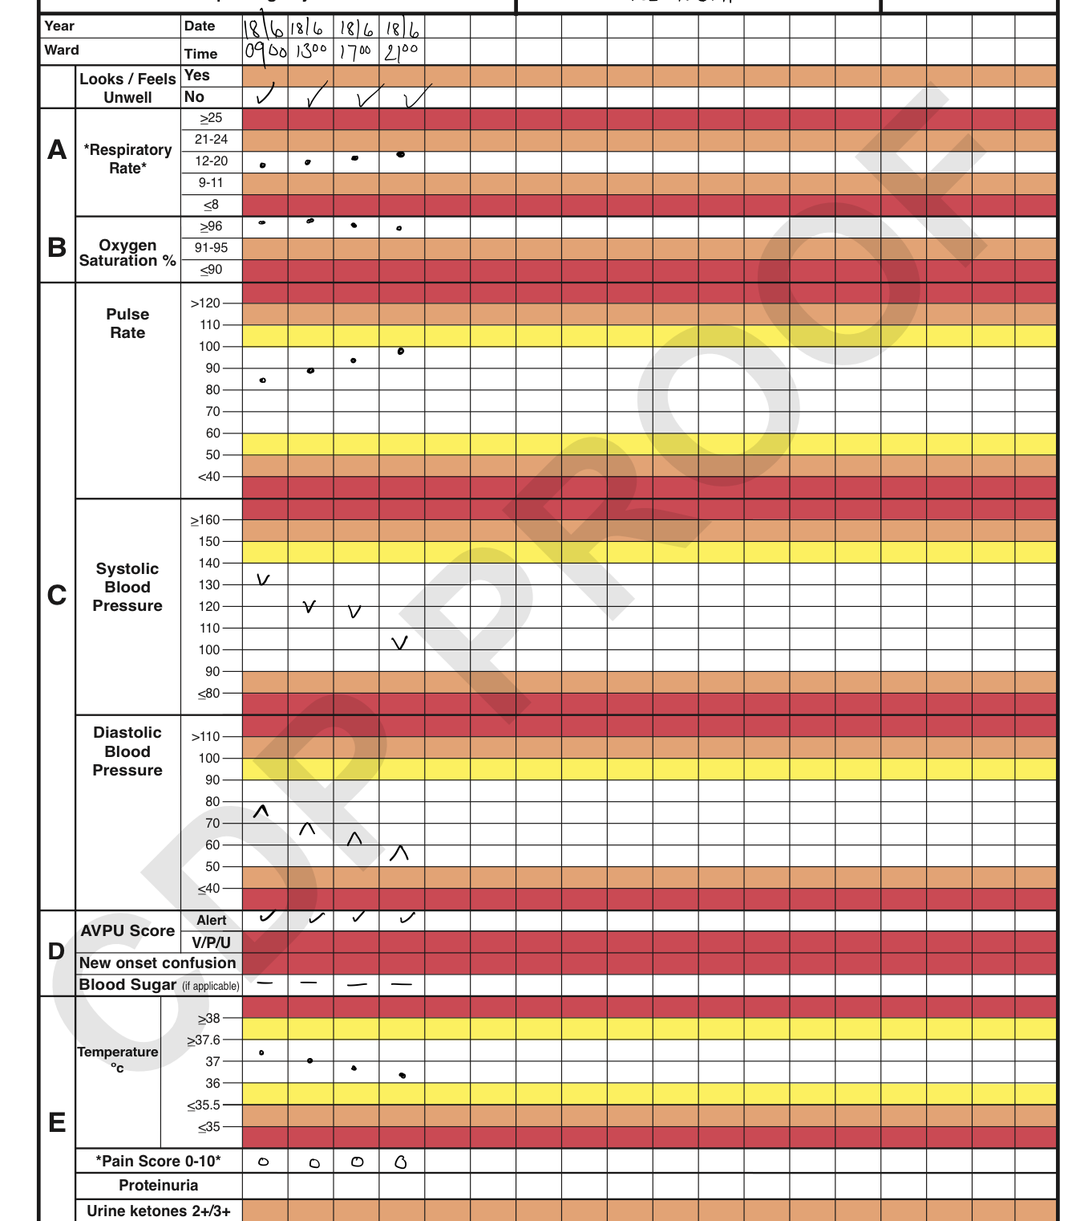
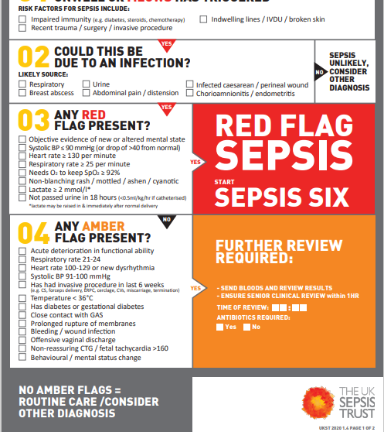
Notes:
1 – Inc HR
2 – Lower systolic
3 – additional signs pregnancy specific
4 – Note on lactate – can be raised during or soon after birth – normal part of labour and can often be 4 – 5 and not be septic
5 – point to note for later that we worry about raised diastolic more than on the general side

Slide 19
Treatment
Sepsis 6
Caution with fluid resuscitation
Delivery
Notes:
Fluid resuscitation should be commenced concurrently – the volume of fluid required may be underestimated. An initial fluid challenge of 500mL of crystalloid over 15 minutes should be given.
Fluid resuscitation in sepsis is similar to fluid resuscitation in PPH and should be commenced ASAP.
Women who do not respond to this fluid challenge i.e. have persistent hypotension or persistently elevated lactate levels have septic shock and are critically unwell, requiring transfer to ITU.

Slide 20
MBRRACE-UK: effective communication when managing sepsis
A widespread tendency for trainee doctors not to contact consultant obstetricians and anaesthetists in a timely way
The severity of the woman’s condition was not always communicated to all members of the maternity team
Appropriate critical care was not always given
Reluctance to investigate and manage sepsis as aggressively as if not pregnant
Notes:
Usually gradually evolving – not a sudden emergency, lowers our suspicion

Slide 21
Pre-eclampsia

Slide 22
Pre-eclampsia
Abnormal trophoblastic invasion of the placenta to the uterine vessels
Vasoconstriction
Endothelial damage
Capillary leak
Hypercoagulability
Platelet dysfunction
Hypertension
Proteinurea
HELLP
Seizure
Intrauterine growth restriction (IUGR)
Notes:
Capillary leak causes pulmonary and cerebral oedema.
Fluid redistribution occurs

Slide 23
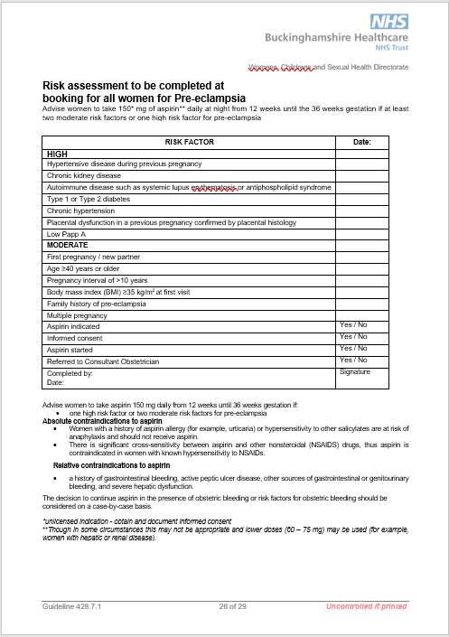
Who is at risk?
First pregnancy (primip)
Increased maternal age
Family history
Black race
Chronic renal disease
Chronic hypertension
Raised BMI
Diabetes
Notes:
Talk about aspirin
Changing population causing an increase in people at risk

Slide 24
Definitions
Degrees of hypertension:
Hypertension: Blood pressure (BP) of 140/90 - 159/109mmHg
Severe Hypertension: Blood pressure of 160/110 mmHg or more
Chronic hypertension:
Hypertension present at booking visit or before 20 weeks, or that is being treated at time of referral to maternity services.
Gestational hypertension:
New hypertension presenting after 20 weeks without significant proteinuria.
Pre-eclampsia:
New hypertension presenting after 20 weeks with significant proteinuria (1+ urine dip/PCR >30 mg/micromol)
Severe pre-eclampsia:
Pre-eclampsia with severe hypertension and/or with symptoms, and/or biochemical and/or haematological impairment.
Eclampsia:
Convulsive condition associated with pre-eclampsia.

Slide 25
Risks
Hypertensive emergencies:
CVA
Pulmonary oedema (highest risk 48-72 hrs postpartum)
Renal failure
Seizure (eclampsia)
Placental abruption
Intrauterine growth restriction (IUGR)
HELLP syndrome
Long term increased risk of cardiovascular disease (4-fold hypertension, 2-fold ischaemic heart disease)

Slide 26
Presenting symptoms
None!
Headache and/or visual disturbances
Oedema – particularly to face
Epigastric pain
Abnormal reflexes/clonus
Hypertension
Proteinurea
Abnormal haematological findings

Slide 27
Management
BP control
Oral antihypertensives (labetalol and nifedipine)
IV antihypertensives
Seizure control/prophylaxis
MgSO4 – also helps with fetal neuroprotection
Fluid restriction – 80mls/hr (or 1ml/Kg/hr) until postnatal diuresis
Delivery – often pre-term
Continuous electronic fetal monitoring
Challenges with anaesthesia
Notes:
Can cause drop in platelets so GA often recommended.
Intubation causes hypertension which can then lead to a cerebral haemorrhage.

Slide 28
Postpartum Haemorrhage

Slide 29
Definition
Antepartum haemorrhage – bleeding in pregnancy
Postpartum haemorrhage (PPH) - blood loss more than 500mls
Massive obstetric haemorrhage (MOH) >1500mls
Primary PPH within 24 hours of birth
Secondary PPH >24rs and up to 6 weeks
Notes:
Not always obvious. Could be concealed. Pregnant women compensate really well due to increased blood volume.
Increased blood volume (40-45%) in pregnancy

Slide 30
Causes
Tone 70%
Tissue 20%
Trauma 10%
Thrombin <1%
Notes:
Blood flow to uterus 500-800mls per minutes
Discuss in relation to 4Ts
Tone – Placental implantation and ruptured blood vessels. Mechanism to stop bleeding following delivery of placenta.
Tissue – how this impacts contraction – could be a blood clot
Trauma – can be high up and not immediately visible
Thrombin- usually known antenatally and prepared for.

Slide 31
Treatment/management
Massive haemorrhage protocol
Identification of 4Ts
Catheterisation
Fluid resuscitation
Uterotonics
Uterine massage/bimanual compression
TXA
EUA
Bakri balloon
Vaginal pack
B-Lynch/brace suture
Hysterectomy

Slide 32
Enhanced Maternal Care
INCLUSION:
Post-partum haemorrhage with cardiovascular instability or significant clinical concern.
Women requiring invasive monitoring (arterial line)
Severe pre-eclampsia
Infusions requiring closer monitoring (e.g., magnesium, intravenous antihypertensives (labetalol or hydralazine)
Sepsis with clinical concern.
Anyone with an ongoing oxygen requirement delivered via facemask or nasal cannula.
EXCLUSION:
Any woman requiring level 3 care.
Any woman with worsening respiratory failure or an increasing oxygen requirement (≥ 40%) or that is likely to require invasive or non-invasive ventilation.
Sepsis not responding to initial resuscitation.
Vasopressor infusion
Any woman who is of such significant clinical concern by senior clinicians that EMC is deemed unsuitable.
Unavailability of trained midwives to carry out necessary EMC care or 1:1 care
Notes:
Automatic referral to CCOT
MDT review at least twice daily
1:1 midwifery care – if this can’t be maintained, liaise ICU re transfer

